Slide 1
Chapter five
Enterprise Data Management

Slide 2
Chapter outline
Introduction to database engine
Database Development hierarchy
Four types of JDBC, JNDI, DBCP
Connection, Statement, and ResultSet objects
Transaction Mode, Native SQL
Advanced Database Techniques
Database Optimization
Concurrency Control

Slide 3
Introduction to database engines

Slide 4
MySQL Database
It is owned by Oracle with both Open Source and Commercial version.
High performance, ease to use, and support large-scale applications.
It runs on multiple platforms (Linux, Windows, Solaris, Macintosh, etc.)
Many enterprises are using it (Facebook, Twitter, Pinterest, etc.).
http://en.wikipedia.org/wiki/Programming_languages_used_in_most_popular_websites
MySQL Fundamental Software
MySQL Community Server (General Public License)
MySQL Workbench (Client GUI Tool)
Connector/ODBC (ODBC library)
Connector/J (JDBC library)
It is chosen for this course.

Slide 5
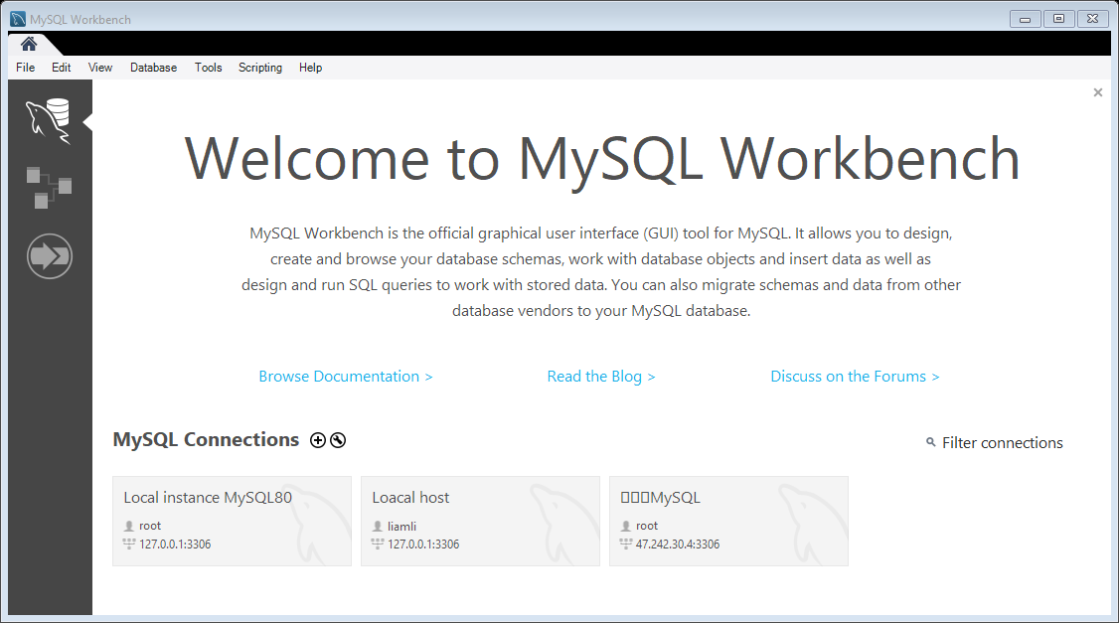
MySQL Workbench (Client GUI Tool)

Slide 6
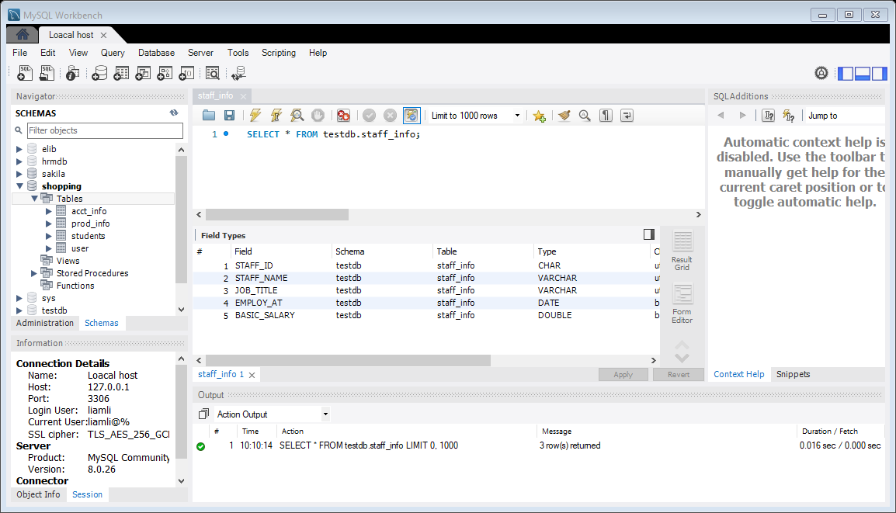
SQL Development IDE

Slide 7
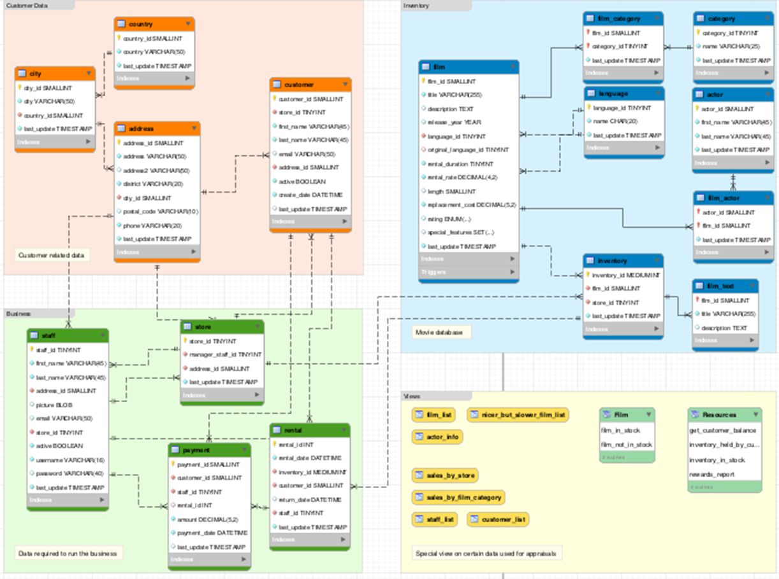
Data Modeling
Generate the ER diagram
from SQL scripts

Slide 8
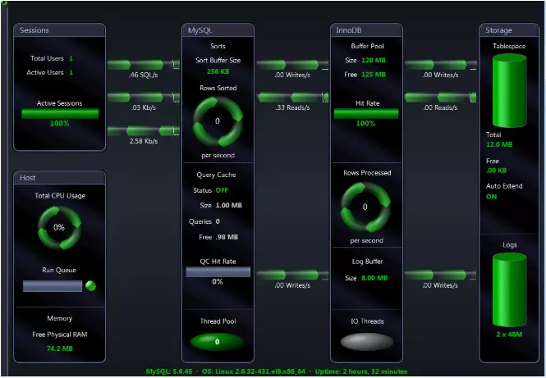
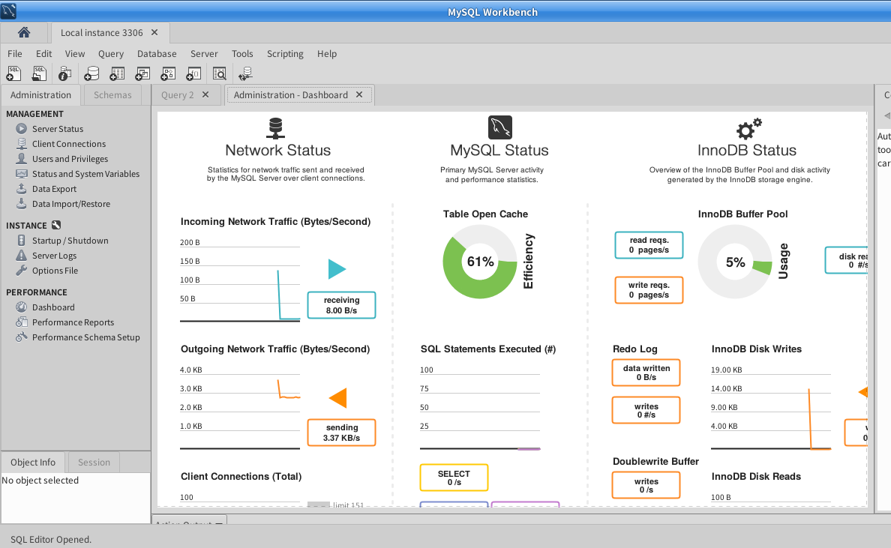
MySQL Monitoring Tools
Build-in monitor tool vs third party software (Spotlight on MySQL).
Help to find the bottleneck.

Slide 9
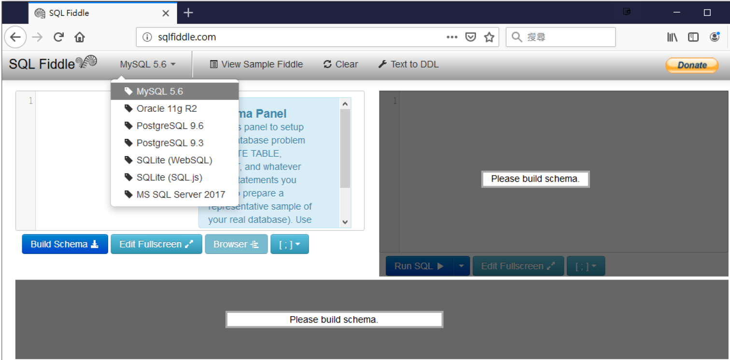
Online SQL Testing Platform
SQL FIDDLE: support different database engines.
http://sqlfiddle.com/

Slide 10
Database development hierarchy

Slide 11
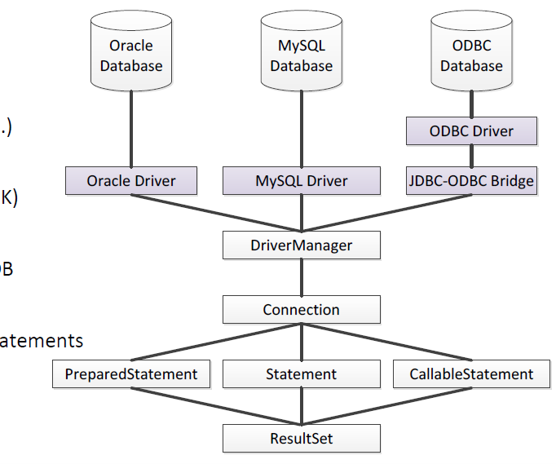
Database Development Hierarchy
Development Hierarchy in Java
JDBC Architecture
Four types of JDBC
DB libraries for Java
Driver Manager
JDBC library (inside JDK)
Connection
Make connection to DB
Statement
Store routines, SQL Statements(DCL, DDL, DML, DQL)
Result Set
Resulting data

Slide 12
Java Database connectivity (JDBC)

Slide 13
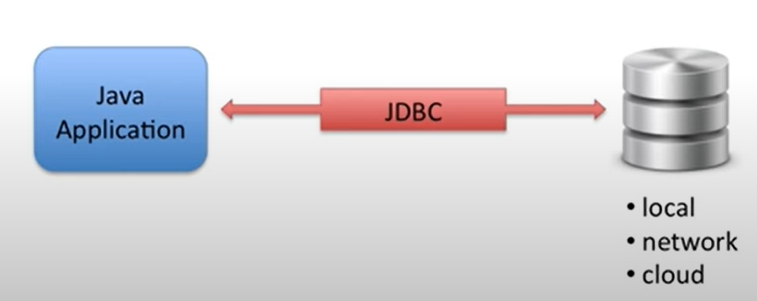
What is Jdbc?
JDBC
Allows Java applications to connect to a relational database

Slide 14
JDBC architecture
JDBC Driver
Provides connection to a database
Converts JDBC calls to for specific database
JDBC driver implementations
Provided by database vendor

Slide 15
Databases Communication Approach
Database servers are installed in different environments (machines, OS, file systems, code pages, etc.), and there are many ways for applications to communicate with them.
Java applications use JDBC to communicate with databases.
Java Database Connectivity (JDBC) is developed by Sun Microsystems.
Sun Microsystems released JDBC as part of JDK 1.1 on 1997.
Latest version is JDBC 9.4 specified in JSR 221 and is included in Java 8, 11 and 16.
Industrial standard for Java to access enterprise level database engines.
Due to the complexity of enterprise systems, JDBC provides four types of communication approaches for system administrators to architect.
Type 1: JDBC-ODBC Bridge, Type 2: Native API, Type 3: Middleware, and Type 4: Pure Driver

Slide 16
JDBC Architecture
Type 1 (Bridge): JDBC-ODBC Bridge
Type 2 (Native API): A native API partly Java technology-enabled driver
Type 3 (Middleware or Network Protocol): Pure Java Driver for Database Middleware
Type 4 (Thin Driver): Direct-to-Database Pure Java Driver
Java Application
Java Application
Java Application
Java Application
JDBC API
JDBC API
JDBC API
JDBC API
Bridge Driver
Native Driver
Type 3 Driver
Thin/Type 4 Driver
ODBC
Middleware
Component or
Server
DSN
Native API
Driver
DB
DB
DB
DB
DB
DB

Slide 17
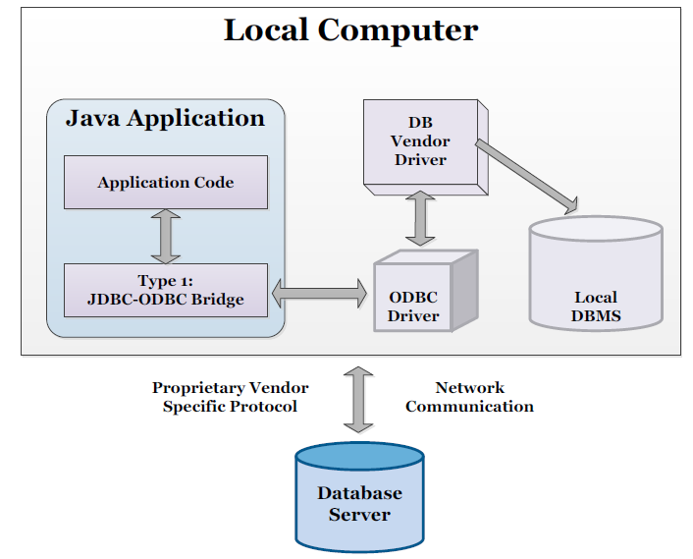
Type 1: Bridge
Using JDBC bridge to access ODBC drivers installed on a local computer.
One of the oldest ways to connect database engines.
ODBC requires to setup a Data Source Name (DSN) that represents the target database.
Software Requirements
Database client-side software
ODBC driver
JDBC library
Typical database engines
Microsoft SQLServer
Microsoft Access
Microsoft Excel
AS/400

Slide 18
Open Database Connectivity (ODBC)
Using standard C programming interface for accessing database and aim to make it independent of database systems and operating systems.
Can be seemed as a Windows driver to connect database like connecting a hardware device (printer, scanner, camera, etc.), and applications use this ODBC driver to connect and access the database engines.
Generally slow and cannot handle the traffic. However, ODBC driver can support different types of database engines.
Some legacy systems provide ODBC drivers for accessing their unique file systems as a database tables.
Easy to setup database connection and configure user authorities.
Suitable for small size applications, report generator tools, and Microsoft products (Access, Excel, etc.).
Good for proof of concept (POC) purpose.

Slide 19
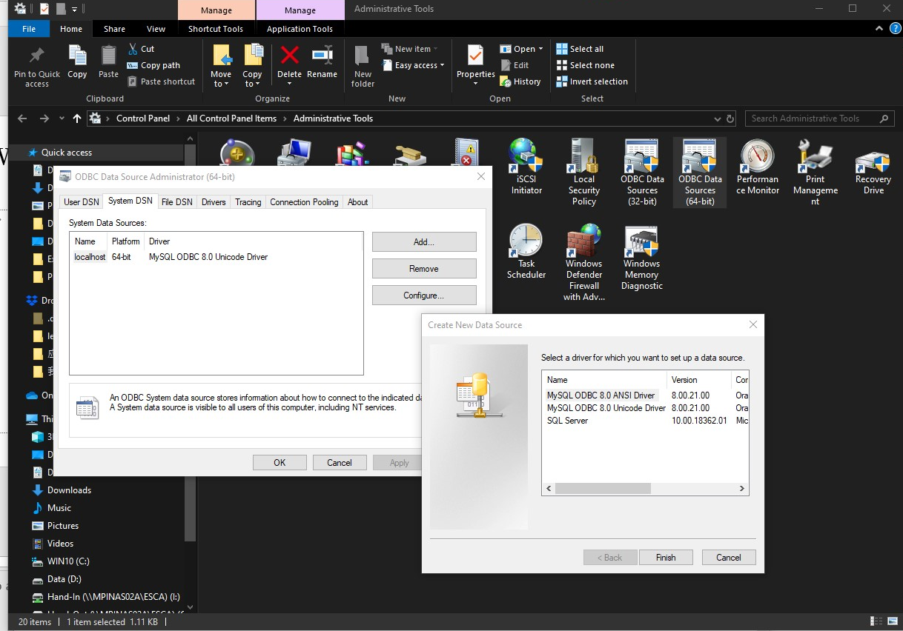
Windows ODBC setup
Create a DSN (Data Source Name) in the Windows platform.

Slide 20
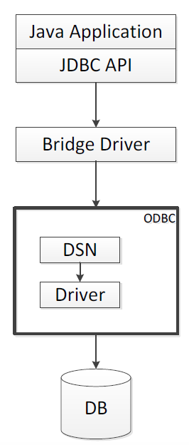
Type 1: JDBC-ODBC Bridge
The bridge provides JDBC access via ODBC driver. ODBC binary code must be loaded on each client machine.
Sun provides a JDBC-ODBC Bridge driver appropriates for experimental use and for situations when no other driver is available.

Slide 21
Type 1 Characteristics
Advantages
Allows access to most of the database engines.
Disadvantages
Since it is not written purely in Java, it is not portable. It only works on Windows and Solaris platforms.
A JDBC call is required to go through and come back the ODBC layer so it is the slowest approach.
Clients are required to install ODBC driver which is not suitable for standalone applications.

Slide 22
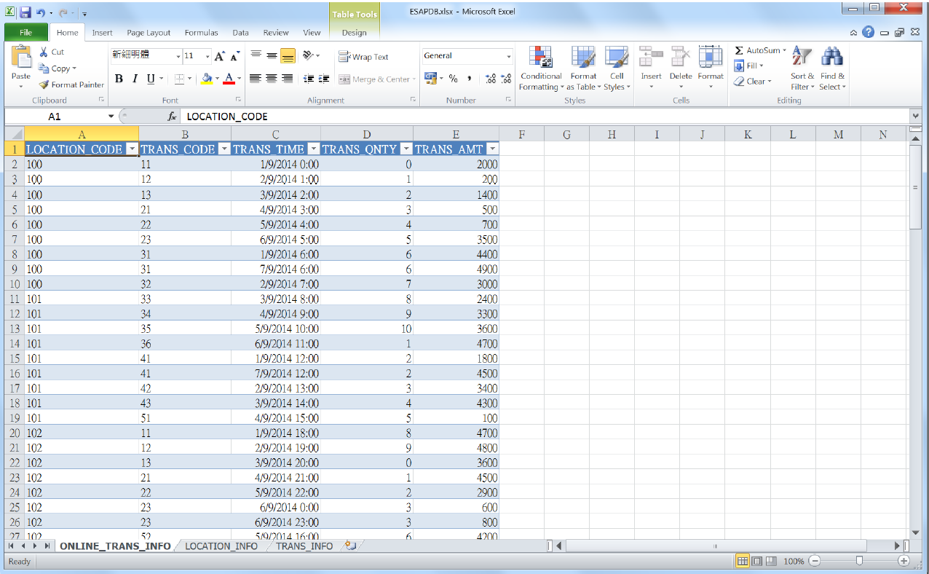
Type 1 Example
A Microsoft Excel file can be worked as a database, and each spreadsheet inside the file will represent a database table.

Slide 23
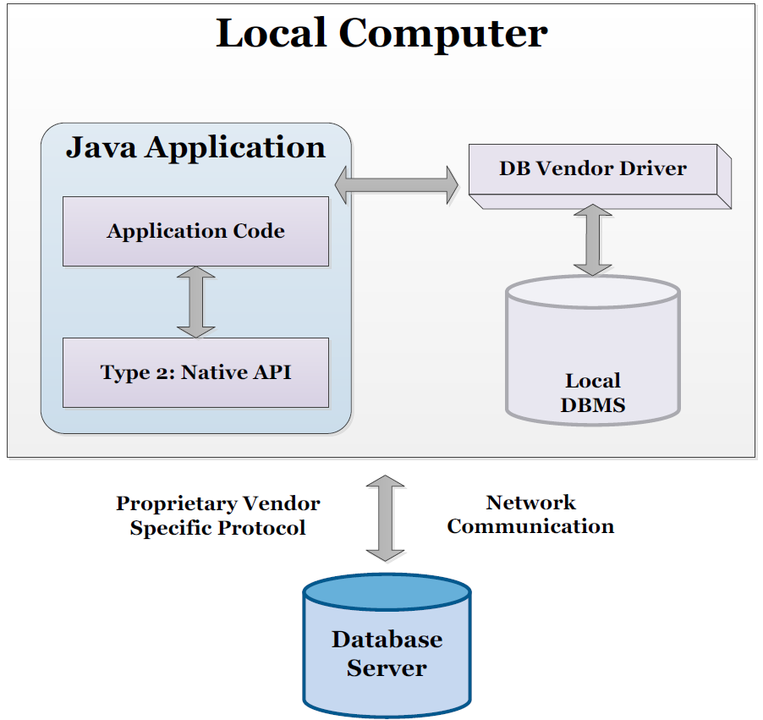
Type 2: Native
Type 2 driver uses native API calls of the desired database.

Slide 24
Type 2: Native
Type 2 driver converts JDBC method calls to the native API (C, C++, etc.) calls of the desired database.
Software Requirements
Database client-side software
Database library for Java
JDBC library
Typical database engines
Database that support Java

Slide 25
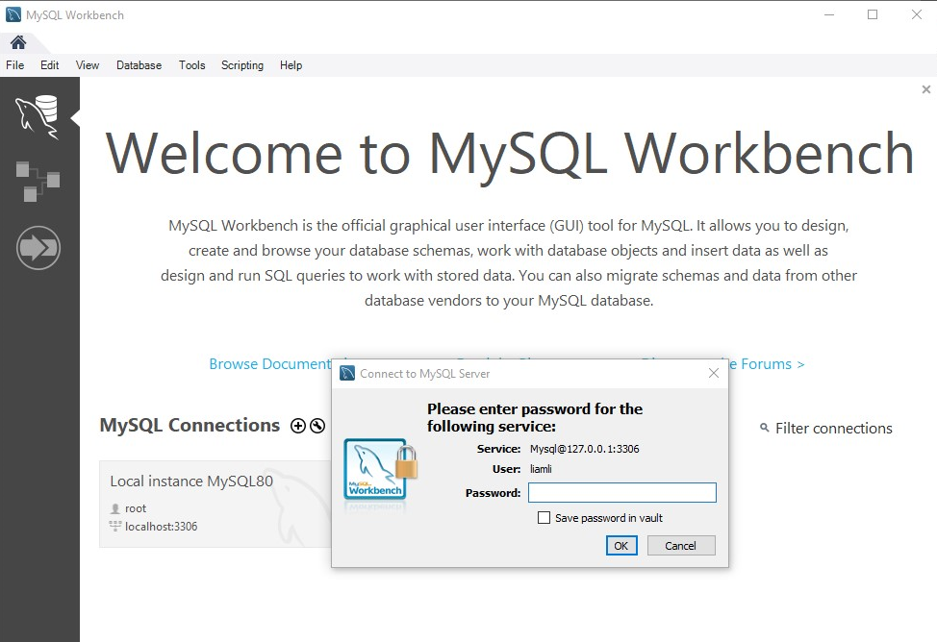
Type 2: Native API
Using database client-side software to connect a remote database server

Slide 26
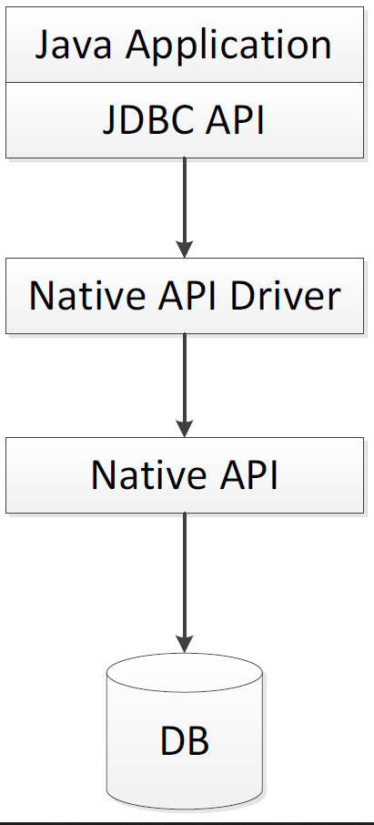
Type 2: A native API Partly Java Technology-Enabled Driver
Also named as Native-API driver, uses the client API for database engines (Oracle, MySQL, IBM DB2, etc.) to connect.
Converts JDBC calls into the libraries of the client-side database software to access the database servers.
Like the bridge driver, it requires the binary code to be loaded on each client machine.

Slide 27
Type 2 Characteristics
Advantages
Since there is no implementation of ODBC, it is faster than type 1.
Provide some native advanced functions of database engines.
Disadvantages
Require to install client-side database software.
Not all database software has the client-side library and interface.
The driver is platform dependent.

Slide 28
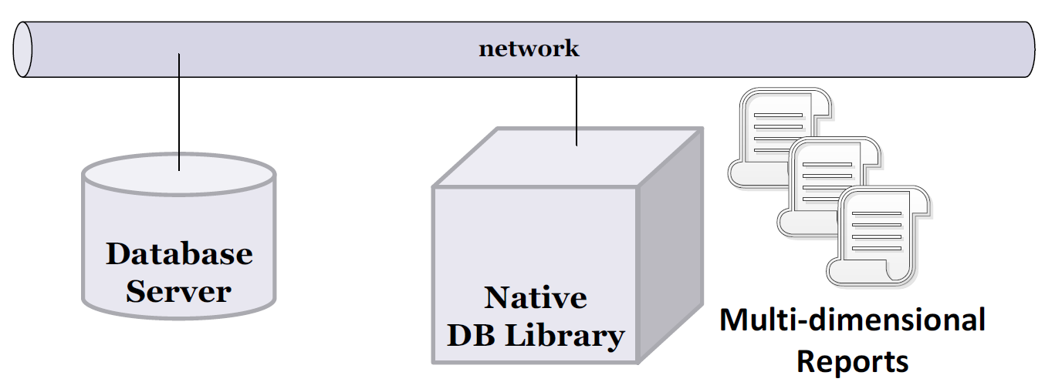
Type 2 Example
Advance reporting tools require database native libraries.
SQL Server Reporting Services (SSRS), Crystal Reports, etc.
https://msdn.microsoft.com/en-us/library/dn749856.aspx

Slide 29
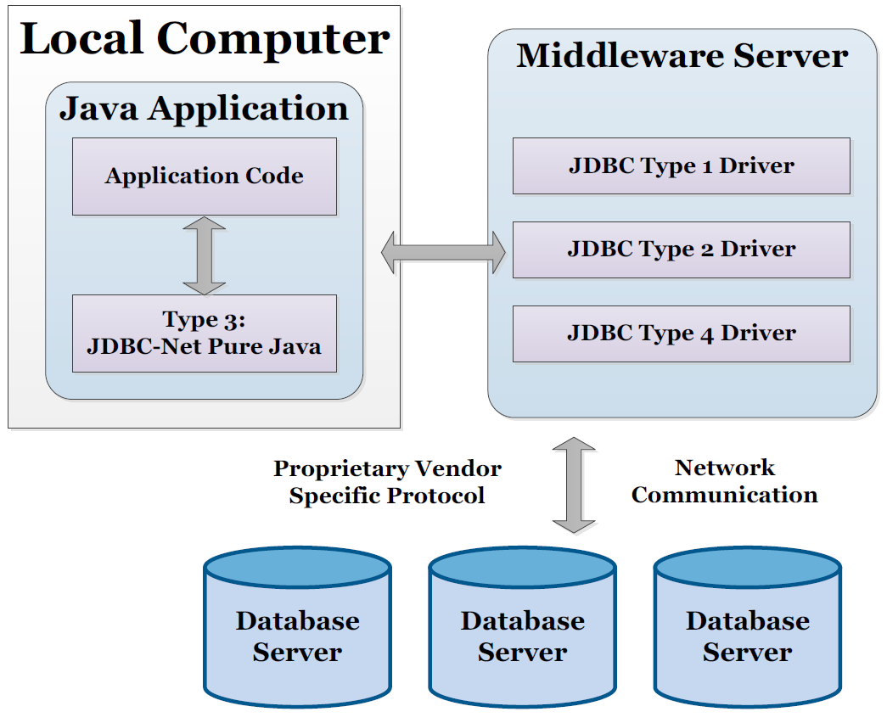
Type 3: Network Protocol (Middleware)
Set up a middleware server for database communication.

Slide 30
Type 3: Network Protocol (Middleware)
JDBC clients use the standard network protocol (socket, RMI, web services, etc.) to communicate with a middleware (application server) and forward the requests to the desired databases.
It is a 3-tier approach to access the database engines.
Software Requirements
JDBC library
Typical database engines
Could be anything even files with different file systems (Windows, Linux, Macintosh, etc.)

Slide 31
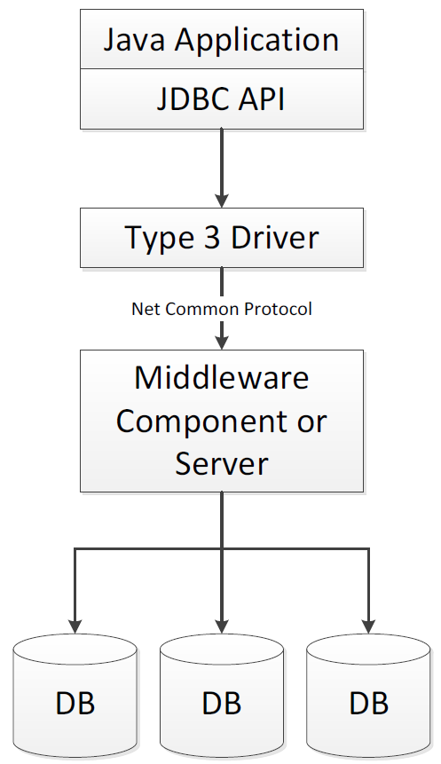
Type 3: Pure Java Driver for Database Middleware
Passed the JDBC requests through a network protocol to the middleware.
Then, it translates and transfers the requests to the desire database engines.

Slide 32
Type 3 Characteristics
Advantages
It is the most flexible and extensible among all JDBC types.
The database library is inside the middleware, so client machines do not need to install any database software and driver.
This driver is written purely in Java and hence suitable for web applications
It allows multiple databases access efficiently.
The network protocol between middleware and client can be designed to make client JDBC become very small and fast to load.
Provides support for caching (connections, query results, etc.), load balancing, and advanced system administration such as filtering, blocking, logging, and auditing.
Disadvantages
It requires another backend server to install and maintain.
It requires more programming efforts to implement the middleware.

Slide 33
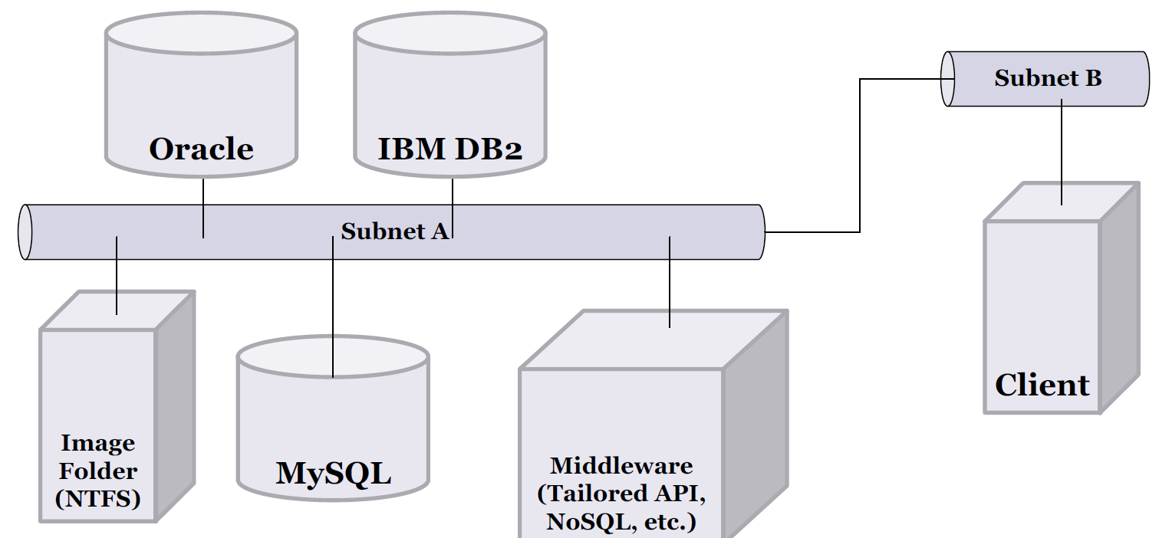
Type 3 Example
A middle server to connect three databases and a folder (image files).
Able to connect all JDBC types (Type 1, 2, 4) and even file system (FAT, EXT, NTFS, etc.).

Slide 34
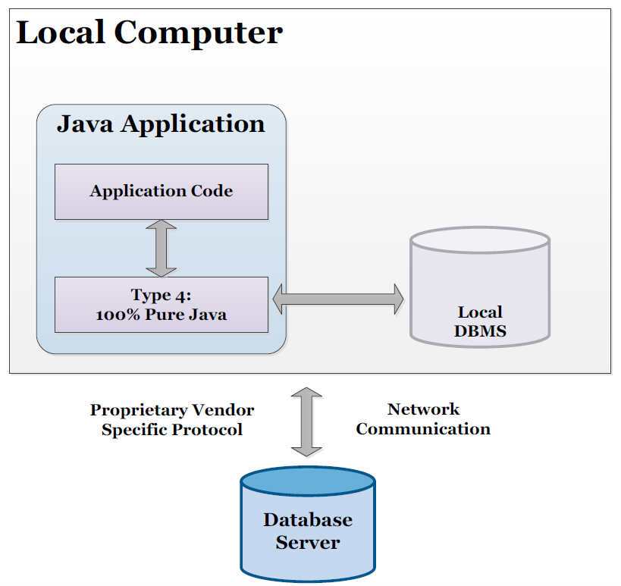
Type 4: Thin Driver
Type 4 driver is a pure Java-based driver that communicates directly with vendor's database.

Slide 35
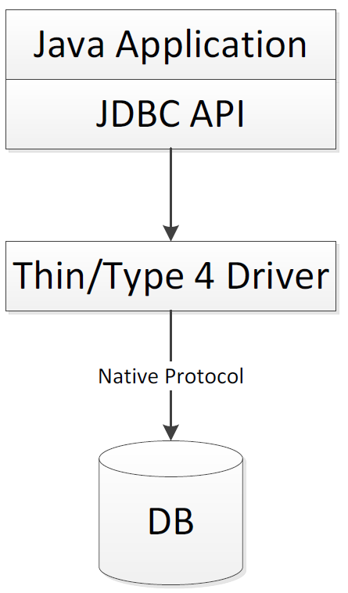
Type 4: Direct-to-Database Pure Java Driver
Uses Java networking libraries to communicate directly with the database server.
Software Requirements
Database library for Java
JDBC library
Typical database engine
Database that support Java

Slide 36
Type 4 Characteristics
Advantages
It is fully written in Java and is the most suitable for developing web applications.
The fewest translation layers, performance is good.
No need to install special software on the client or server.
Disadvantages
Each database will require different libraries (DLL, JAR, etc.) for different programming languages.
Not all database engines have provided these libraries for Java (db2.jar, mysql.jar, oracle.jar, postgres.jar, etc.).

Slide 37
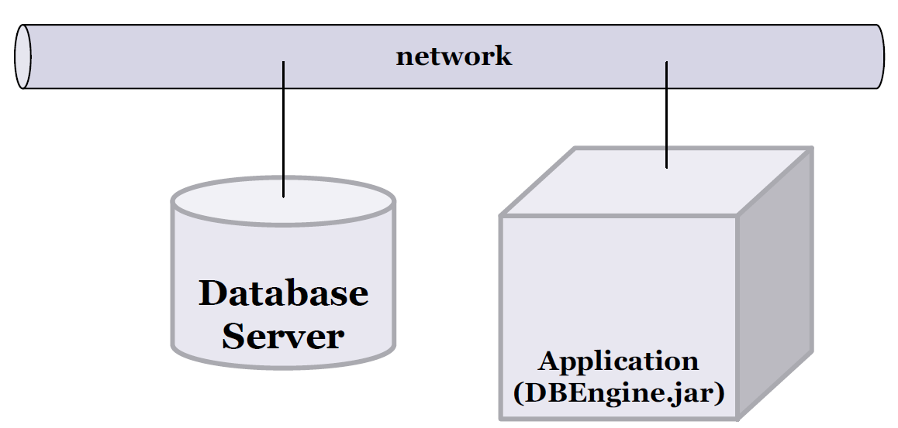
Type 4 Example
Simple standalone Java program.

Slide 38
Summary: Which one should be used?
If a system only accesses one database engine that support Java, we should use type 4 driver to achieve better performance and simpler architecture.
If a system accesses multiple databases at the same time for different application systems, type 3 driver is preferred.
Type 2driver is useful in situations where a type 3 or type 4 driver is not available. It is often used when client requires more database engine's native functions.
Type 1driver is not considered to be a deployment-level driver and it is typically used for development and testing purposes (POC) only. It is often used to connect some legacy systems or Microsoft products.

Slide 39
Driver Manager and Connection Object

Slide 40
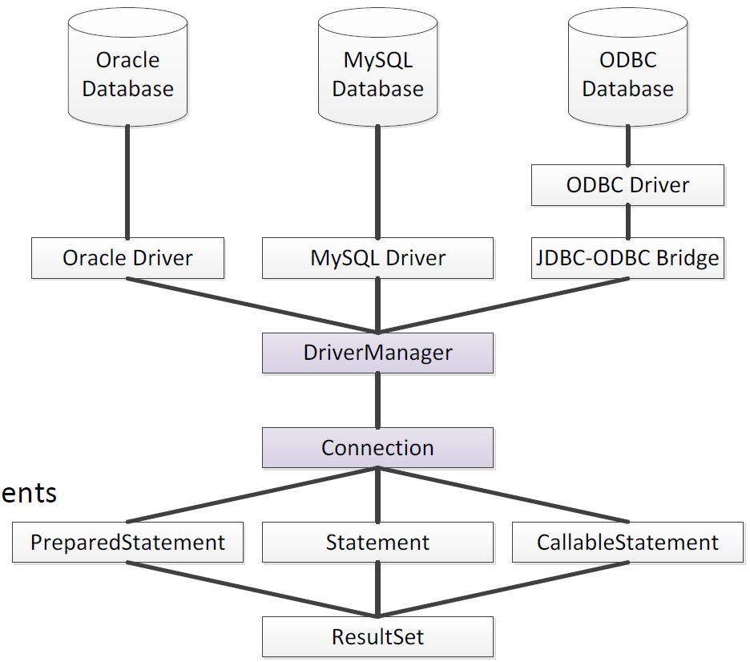
Database Development Hierarchy
Development Hierarchy in Java
1.JDBC Architecture
Four types of JDBC
DB libraries for Java
(mysql.jar, oracle.jar, etc.)
2.Driver Manager
JDBC library (inside JDK)
3.Connection
Make connection to DB
4.Statement
Store routines, SQL Statements(DCL, DDL, DML, DQL)
5.Result Set
Resulting data

Slide 41
Database Connection Procedures
Import dependent package
Load driver
Establish connection
Create and execute the statement;
Retrieve results
closes the connection (destroys connection objects);

Slide 42
Conventional Problems
Frequently open and close database connections consume many server resources.
Clients often forget to close the database connections and cannot release the unused resources.
Database engines have limited number of connections.
When database engine is busy and cannot make new connection in time, some of the user requests (transactional data) will be lost by time out (waiting for so long).
When database engine is running out of resource for making new connections, it may shutdown the database service and crash down the applications.

Slide 43
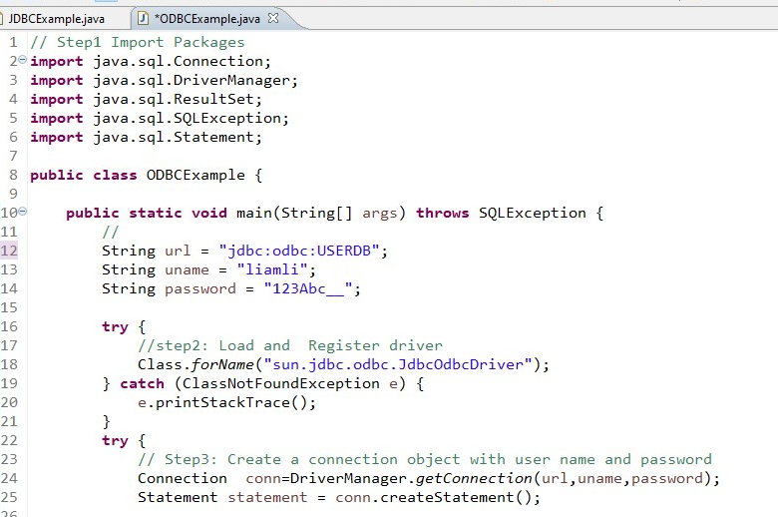
JDBC Driver Manager
DriverManager helps to connect an application based on the database connection string.
We can use DriverManager.registerDriver() to load the drivers.
In JDBC 4.0, the JDBC drivers are automatically loaded based on the class path
Legacy JDBC 3.0 drivers have to be explicitly loaded with Class.forName(theDriverName)

Slide 44
JDBC API
JDBC API is defined in the following packages
Java.sql and javax.sql
Key classes
Java.sql.DriverManager
Java.sql.Connection
Java.sql.Statement
Java.sql.ResultSet
Javax.sql.DataSource (for connection pooling)

Slide 45
Step 1: get a connection to database
In order to connect to database
Need a connection string in form of JDBC URL
Basic syntax
jdac:<driver protocol>:<driver connection details>
Examples
Database | JDBC URL
MS SQL Server | jdbc:odbc:DemoDSN
Oracle | jdbc:oracle:thin@myserver:1521:demodb
MySQL | jdbc:mysql://localhost:3306/demodb

Slide 46
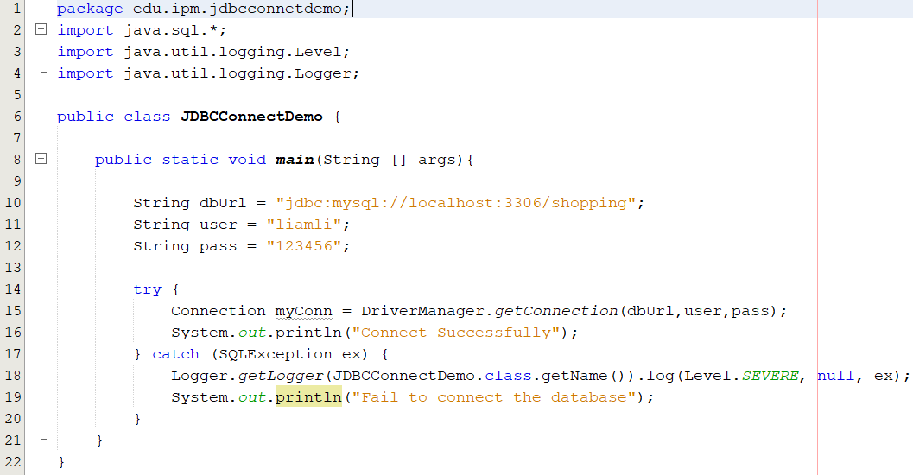
Step 1: get a connection to database
Code snippet for connecting to MySQL
Failure to connect will throw an exception:
java.sql.SQLException: bad url or credentials
java.lang.ClassNotFoundException: JDBC driver not in class path

Slide 47
Implementation
The commonly used approaches to connect database are:
Case 1: Type 4 – Pure Java Driver
Case 2: Type 1 – JDBC-ODBC bridge
Case 3: Java Naming and Directory Interface
Case 4: Database Connection Pool

Slide 48
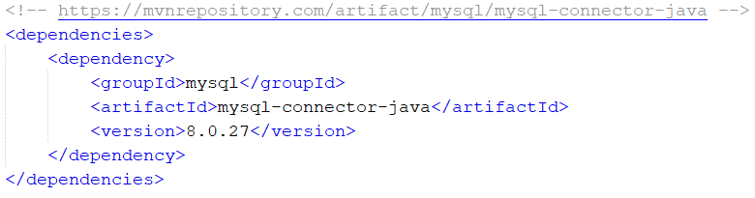
Case 1: MySQL + Pure Java Driver
Development procedures
Install the MySQL Community Server
https://dev.mysql.com/downloads/mysql/
Create a database instance (shopping)
Download the MySQL library for Java (mysql.jar)
https://dev.mysql.com/downloads/connector/j/
Adopt the library in the development project
Write Java programs
pom.xml

Slide 49
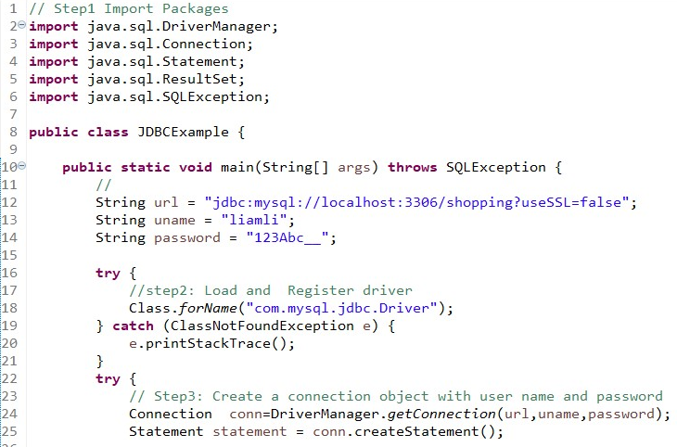
JDBC Example (cont.)

Slide 50
Case2: MySQL + JDBC-ODBC bridge
Development Procedures
Install the MySQL Community Server
Create a database instance (USERDB)
Install the MySQL ODBC Driver
Create a data source name (DSN) in windows for mapping the database instance (USERDB)
Write Java programs

Slide 51
ODBC Example

Slide 52
Case 3: MySQL + JNDI
Development steps
Install the MySQL Community Server
Create a database instance
Download MySQL library for Java (mysql.jar)
Adopt the library in the development project
Install the Tomcat application server
Define a data source reference in the application server
Write Java programs and lookup the reference

Slide 53
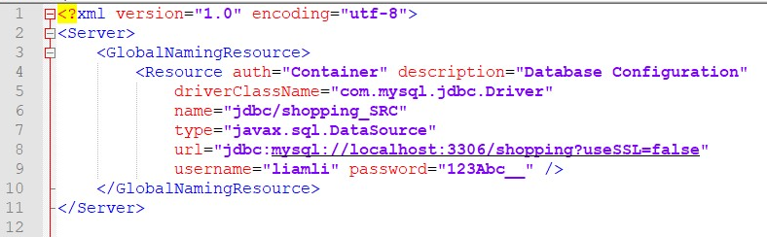
Data Source configuration
Add resource reference tag to /tomcat/conf/server.xml under global naming resource tag
<GlobalNamingResource> tag: defines the JNDI resources for the server
http://tomcat.apache.org/tomcat-8.5-doc/config/globalresources.html
http://tomcat.apache.org/tomcat-8.5-doc/jndi-resources-howto.html

Slide 54
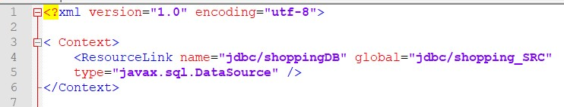
Data Source Configuration (cont.)
Add resource link tag to /tomcat/conf/context.xml under the context tag to map the web.xml with server.xml
<ResourceLink> tag: is used to create a link to a global JNDI resource. Doing a JNDI lookup on the link name will then return the linked global resource.
http://tomcat.apache.org/tomcat-8.5-doc/config/context.html
http://tomcat.apache.org/tomcat-8.5-doc/jndi-resources-howto.html

Slide 55
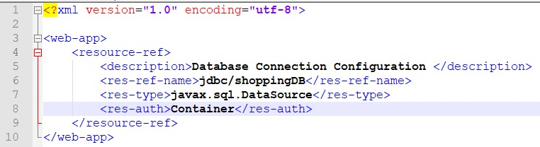
Data Source Configuration (cont.)
Add resource reference tag to local web.xml under web-app tag
<resource-ref>tag: declare the characteristics to be returned for JNDI lookups
http://tomcat.apache.org/tomcat-8.5-doc/config/globalresources.html
http://tomcat.apache.org/tomcat-8.5-doc/jndi-resources-howto.html

Slide 56
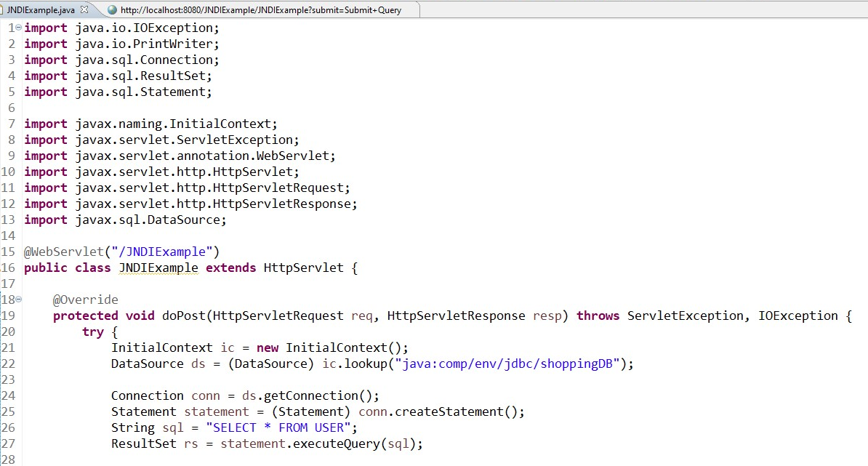
JNDI Example

Slide 57
Case 4: MySQL + DBCP
Development steps
Install the MySQL Community Server
Create a database instance
Download MySQL library for Java (mysql.jar)
Adopt the library in the development project
Install the Tomcat application server
Define a data source reference in the application server
Write Java programs and lookup the reference

Slide 58
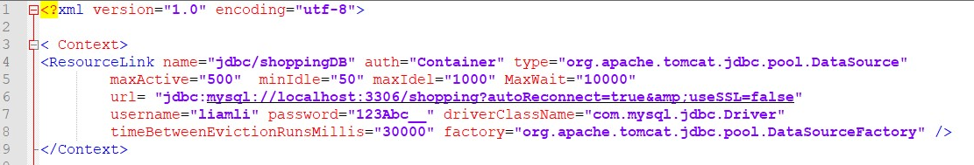
DBCP Configuration
/tomcat/conf/context.xml file and add the resource
Only one configuration files is needed
http://tomcat.apache.org/tomcat-8.5-doc/jdbc-pool.html

Slide 59
DBCP Parameters
maxActive (int)
The maximum number of active connections that can be allocated from this pool at the same time. Default is 100, set to-1 for no limit.
The max_connections in database engine must larger then it.
maxIdle (int)
The maximum number of connections that should be kept in the pool at all times. Default is 100.
Idle connections are checked periodically and connections that been idle for longer than minEvictableTimeMillis will be released.
maxWait (int)
The maximum number of milliseconds that the pool will wait for a connection to be returned before throwing an exception. Default is 30000 (30 second)

Slide 60
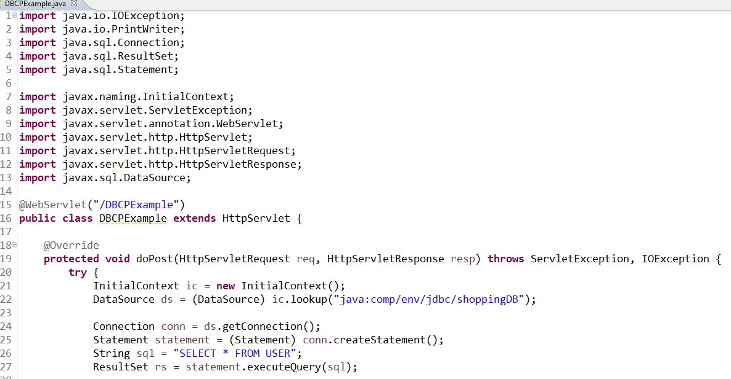
DBCP Example

Slide 61
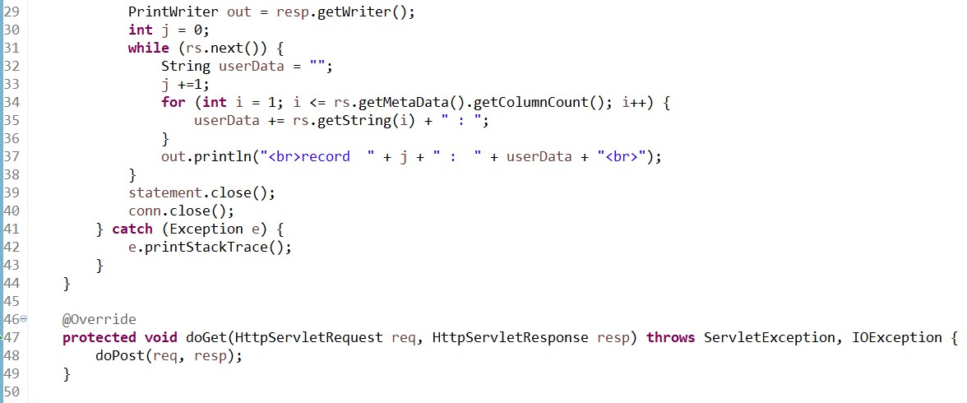
DBCP Example (cont.)

Slide 62
Comparison of Connection Approaches
Different connection methods (ODBC, JNDI, DBCP, etc.) are introduced and they can fulfill the various of enterprise environments
Enterprises concern about stable, robustness, performance, development time, and feasibility (cost)
Hardly to say which one is the best under all circumstances but “do the right thing in the right place”
Understand the system environment (database engine, OS, etc.)
Understand the characteristics of JDBC architecture approaches
Understand the business requirements
Using tools to monitor and test the system performance, and they can help to make a right decision.

Slide 63
Statement Interface

Slide 64
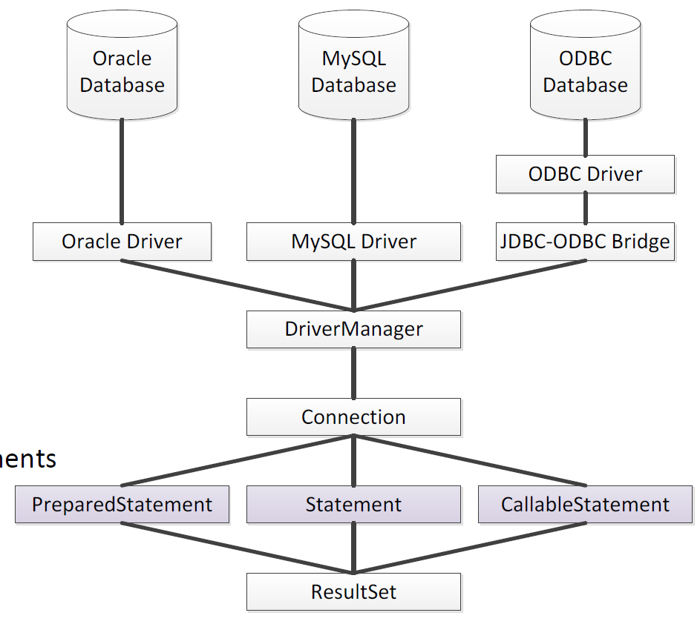
Database Development Hierarchy
Development Hierarchy in Java
1. JDBC Architecture
Four types of JDBC
DB libraries for Java
(mysql.jar, oracle.jar, etc.)
2.Driver Manager
JDBC library (inside JDK)
3.Connection
Make connection to DB
4.Statement
Store routines, SQL Statements(DCL, DDL, DML, DQL)
5.Result Set
Resulting data

Slide 65
SQL Statement Types
DCL –Data Control Language
GRANT, REVOKE
DDL –Data Definition Language
CREATE, DROP, ALTER, TRUNCATE, etc.
DML –Data Manipulation Language
INSERT, UPDATE, DELETE
DQL –Data Query Language
SELECT

Slide 66
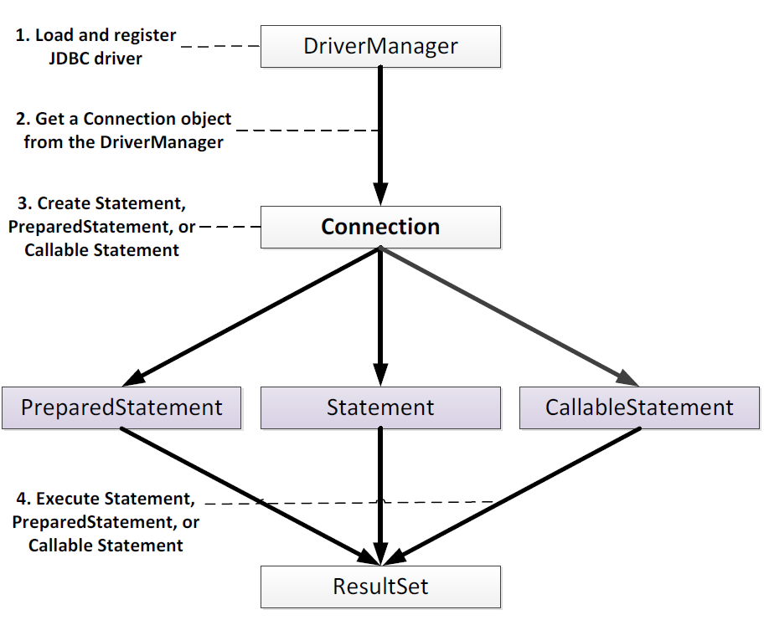
Java Statement Interfaces
There are three types of Java Statement Interfaces
Statement
java.sql.Statement
Prepared Statement
java.sql.PreparedStatement
Callable Statement
java.sql.CallableStatement

Slide 67
Statement Interface
The Statement interface holds your SQL statements and sends to the database engines for further process.
This interface represents a static SQL statement.
Use to execute SQL statements (eg. DDL and DML) and it can return a ResultSet object.
Only one ResultSet object per Statement can be opened at the same time.
http://docs.oracle.com/javase/8/docs/api/java/sql/Statement.html

Slide 68
Commonly used methods in Statement Interface
Boolean execute(String sql)
Executes the given SQL statement.
Returns true if the result is a ResultSet objects or returns false if it is an update count or there are no results.
ResultSet executeQuery(String sql)
Executes the given SQL DQL statement, which returns a single ResultSet object.
Int executeUpdate(String sql)
Executes the given SQL statement, which may be an INSERT, UPDATE, or DELETE statement.
Returns the row count for SQL DML statements or returns nothing for SQL DDL statements.

Slide 69
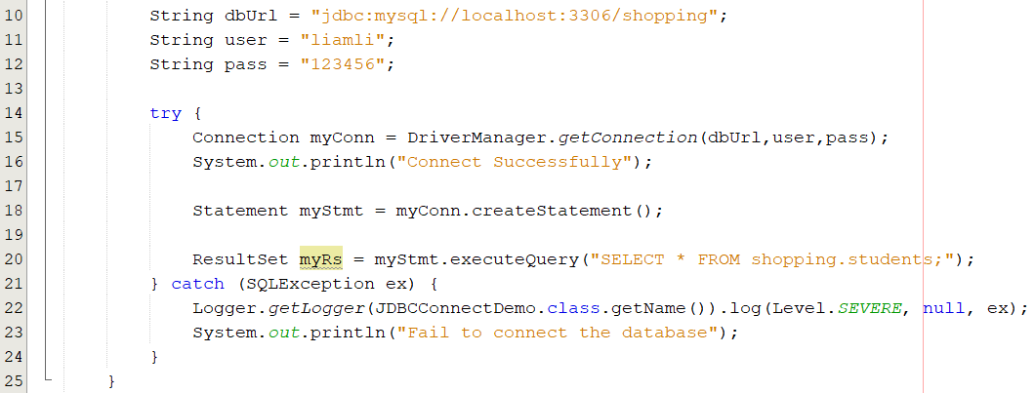
Create and excute a statement object
The statement object is based on connection
It will be used to execute SQL query

Slide 70
Static Statement Problems
It must use single quotes to surround a character field
String sql = "SELECT * FROM USER_INFO WHERE USER_NAME = 'Jone Smith'";
sql = "SELECT * FROM USER_INFO WHERE USER_NAME = '" + name + "'"
When using the INSERT statement, it becomes very awkward
sql = " INSERT INTO USER_INFO VALUES ('1001', '123456', 'Peter')";
sql = "INSERT INTO USER_INFOR VALUES ('" + id + "', '" + pswd + "','" + name + "') ";
What happen if a password contains quotes?
sql = "SELECT * FROM USER_INFO WHERE PASSWORD = '99\" 99'";
sql = "SELECT * FROM USER_INFO WHERE PASSWORD = '88' '88' ";
How about some other special characters (e.g. return line, %)?
How about manipulating the BLOB type data (images, document files, etc.)?

Slide 71
PreparedStatement Interface
This interface extends Statement and represents a precompiled SQL statement.
This interface formulates the dynamic statements executed by the database engine.
This precompiled SQL statement object used for setting parameters and values to the SQL statement.
Using ? symbol to represent a parameter instead of writing the real value.
String sql= "SELECT * FROM USER_INFO WHERE USER_ID = ?";
Prepare the query plan once and able to be reused.
The PreparedStatementinterface documentation.
https://docs.oracle.com/javase/8/docs/api/java/sql/PreparedStatement.html

Slide 72
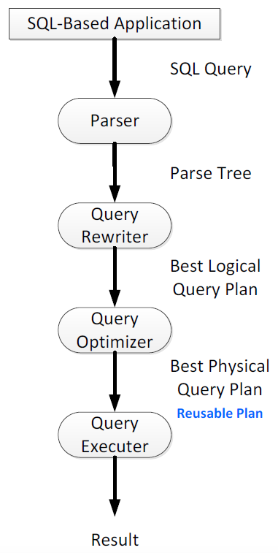
Database “prepares” your SQL
Users send SQL query statement to the database engine.
Database engine reads your SQL, and DBMS Parser creates a logical query plan.
DBMS Query Optimizer receives the logical query plan and chooses the most efficient plan for a given query.
DBMS Query Optimizer creates the physical query plan.
This physical query plan is reusable.
Query Executer finally executes your SQL query.

Slide 73
Reusable Statement
The Statement interface prepares and executes the query plan each time, while PreparedStatement interface prepares the query plan once and then just reuses it.
Use a PreparedStatement interface instead of using the Statement interface for executing a SQL statement many times to reduce the procession time (parsing and optimizing the SQL statement).
However, if a PreparedStatement interface is used only once or twice, it has greater initial overhead from precompiling the SQL statement.

Slide 74
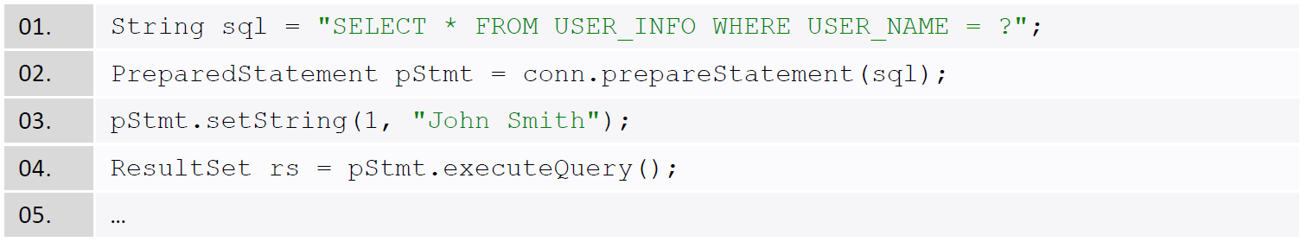
Parameters in PreparedStatement
Use question mark (?) as value parameter in the SQL.
Use parameter, you don't need to care about single quote, double quote and binary large objects issues.
Use (setString, setInt, setDate, setDouble, setBlob, setBytes, etc.) methods to pass different types of values.
Put special characters to SQL statement with setString() method, such as: non-English, double quote, single quote.
Access large object file (images, documents, etc.) with setBlob() method.

Slide 75
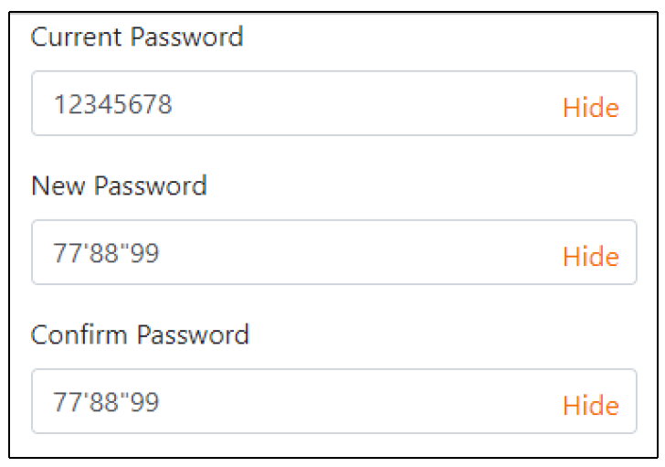
Prepared Statement Example
User wants to change a new password that contains single and double quotes.
Server side programs need to handle the special characters before saving to the database.

Slide 76
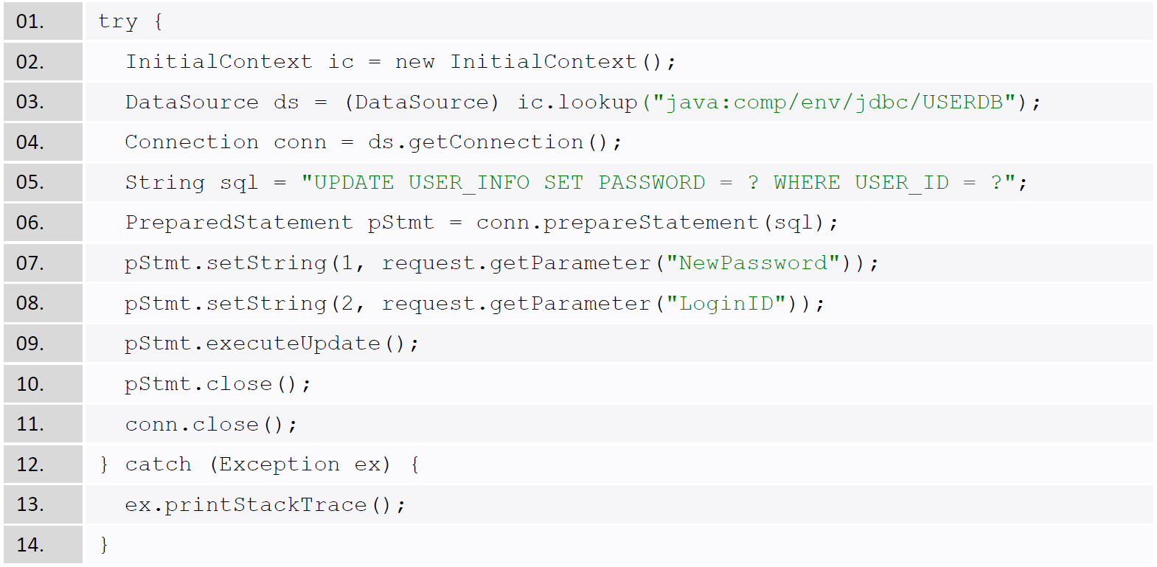
Prepared Statement Example
Handle the special characters before easy.

Slide 77
Advanced SQL Development

Slide 78
MySQL Stored Procedures
People often embed the SQL statements inside the applications (Java, PHP, C#, Python, etc.).
StoreProc is to store the SQL programs (procedures, functions, triggers) inside the database engines to obtain greater security and integrity.
It improves the overall application performance and maintainability.
StoreProc in MySQL appeared after version 5.

Slide 79
Types of Stored Procedures
Procedures
A generic program unit that is executed on request and that can accept multiple input and output parameters.
Functions
A function returns a single value.
Triggers
A program will be activated in response to an activity within the database.
Typically, a trigger will be invoked in response to a DML operation.

Slide 80
Why use Stored Procedures?
They are cached inside the server.
It limits direct access to tables via defined roles in the database.
Securing just the data and the code that accesses it is easier than applying that security within the application code itself.
Programs are stored in one location, and updates and tracking of dependencies becomes easier.
Part of the job requirements of some enterprises for their database programmers.

Slide 81
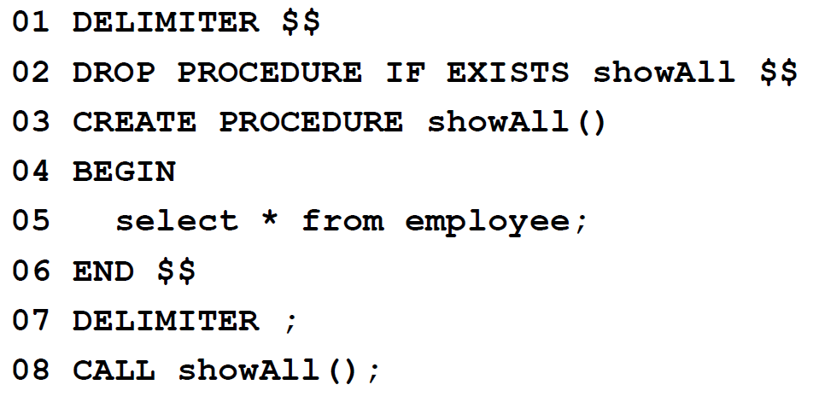
SP Basic Structure
It requires to define a delimiter (//, $$, etc.) on <Line 1>to replace (;) from normal SQL for a termination on <Line 6>
Use (BEGIN, END) block for SQL programming <Line 4, 6>
Delimiter returns back to semi-colon on <Line 7>
Use CALL to execute the stored procedures on <Line 8>

Slide 82
SP Basic Syntaxes
MySQL Stored Procedure Documentation:
http://dev.mysql.com/doc/refman/8.0/en/create-procedure.html
Define variables on <Line 5>
DECLARE
Change the value of a variable on <Line 7>
SET
Loop Statement on <Line 6>to <Line 13>
Label: LOOP,END LOOP
Conditional Statement on <Line 8, 10 , 12>
IF,ELSE,END IF
You can call other stored procedures inside the program on <Line 7, 11>

Slide 83
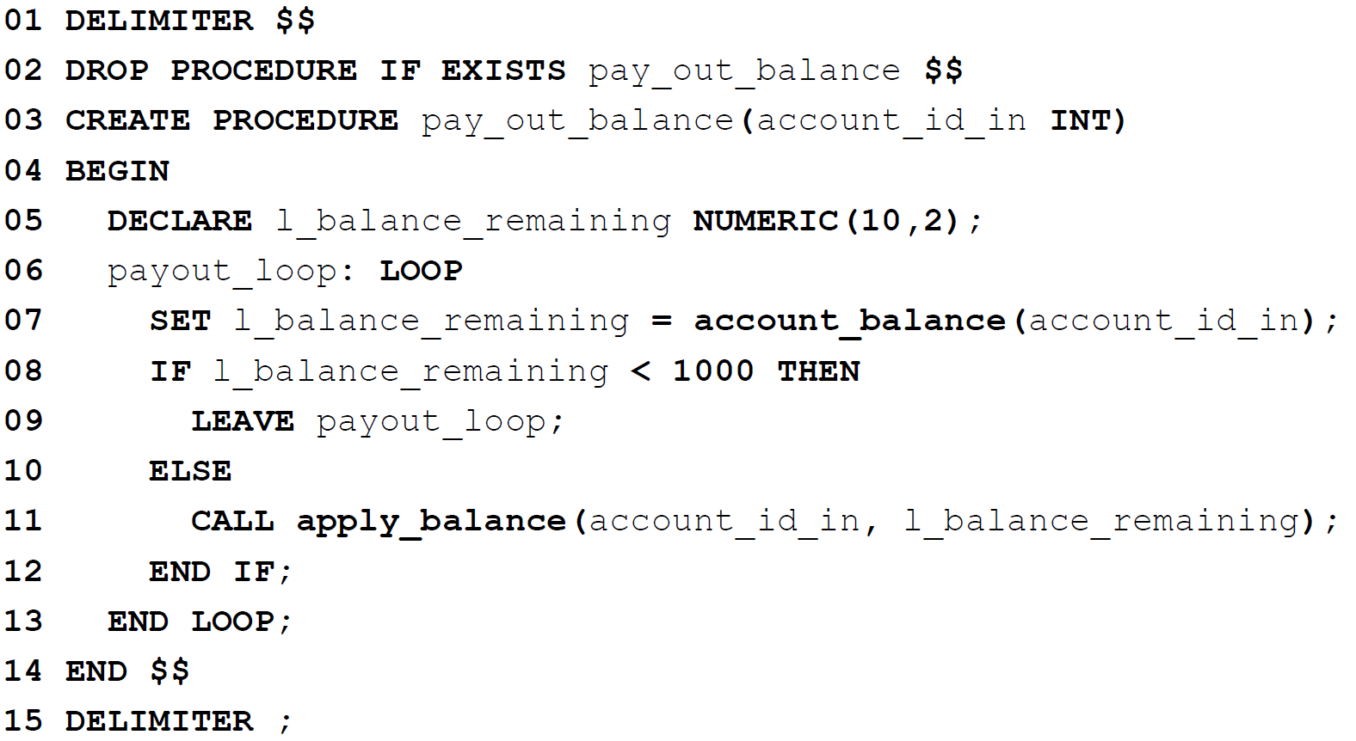
Procedure example

Slide 84
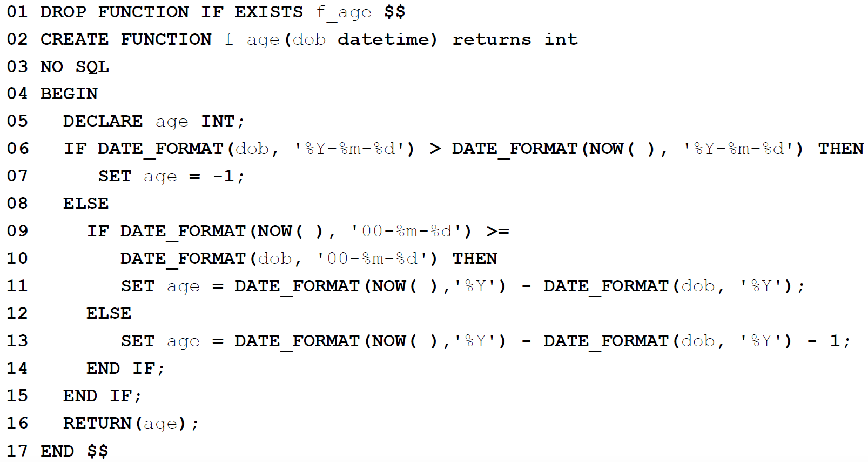
Function Example
A stored function to calculate the current age

Slide 85
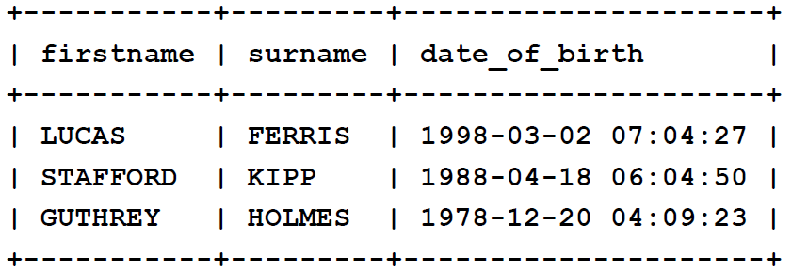
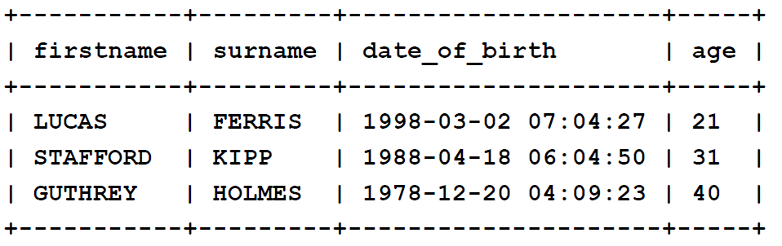
Function Example
A database table EMPLOYEES
If today is 2019-11-15, executing the following SQL will get:
SELECT FIRSTNAME, SURNAME, DATE_OF_BIRTH, f_age(DATE_OF_BIRTH) AS AGE FROM EMPLOYEES;

Slide 86
Trigger
Triggers implement functionality that must take place whenever a certain change occurs to the table.
Because triggers are attached directly to the table, application code cannot bypass database triggers.
Triggers can be defined to fire before or after a specific DML statement executes.
Trigger_time: {before | afger}
Trigger event: {INSERT | DELET | UPDATE}
CREATE TRIGGER trigger_name trigger_time trigger_event ON tbl_name FOR EACH ROW trigger_stmt

Slide 87
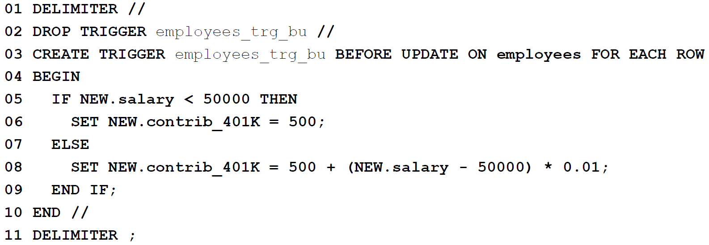
Trigger Example
Create a trigger to maintain a derived column value.
If the new value for the salary column is less than 50000, the contrib_401K column will be set to 500. Otherwise, the value will be calculated differently.

Slide 88
Callable Statement Interface

Slide 89
Database Development Hierarchy
Development Hierarchy in Java
1. JDBC Architecture
Four types of JDBC
DB libraries for Java
(mysql.jar, oracle.jar, etc.)
2.Driver Manager
JDBC library (inside JDK)
3.Connection
Make connection to DB
4.Statement
Store routines, SQL Statements(DCL, DDL, DML, DQL)
5.Result Set
Resulting data

Slide 90
Callable Statement Interface
This interface represents a database stored routines.
Stored Procedures: a group of SQL statements.
Stored Functions: programmable statements to calculate something.
http://docs.oracle.com/javase/8/docs/api/java/sql/CallableStatement.html
Execute or call user defined procedures or functions in database that is similar to PreparedStatement interface.
For housekeeping jobs (a series of SQL statement)
Maintenance, rebuild indexes, grant user authority, export statistical and analytical data, reporting, etc.
For handling transactions (to do some data verification, calculation, modification, etc.).

Slide 91
Steps for invoking CallableStatement
Invoke the Connection.prepareCall method to create a CallableStatemen object.
Invoke the CallableStatement.setXXXmethods to pass values to the input (IN) parameters.
Invoke the CallableStatement.registerOutParameter method to indicate which parameters are output-only (OUT) parameters or input and output (INOUT) parameters.
Invoke the CallableStatement.executeUpdate method to call the stored procedure.
If the stored procedure returns result sets, retrieve the result sets.
Invoke the CallableStatement.getXXX methods to retrieve values from the OUT parameters or INOUT parameters.

Slide 92
Commonly used methods in CallableStatementInterface
void addBatch(String sql)
Adds SQL command to the current list of commands and can be executed as a batch by executeBatch() method call.
int[] executeBatch()
Submits a batch of commands to database for execution.
ResultSet executeQuery()
Executes the SQL query in this CallableStatement object and returns the ResultSet object generated by the query.
ResultSetMetaData getMetaData()
To get database and table information.

Slide 93
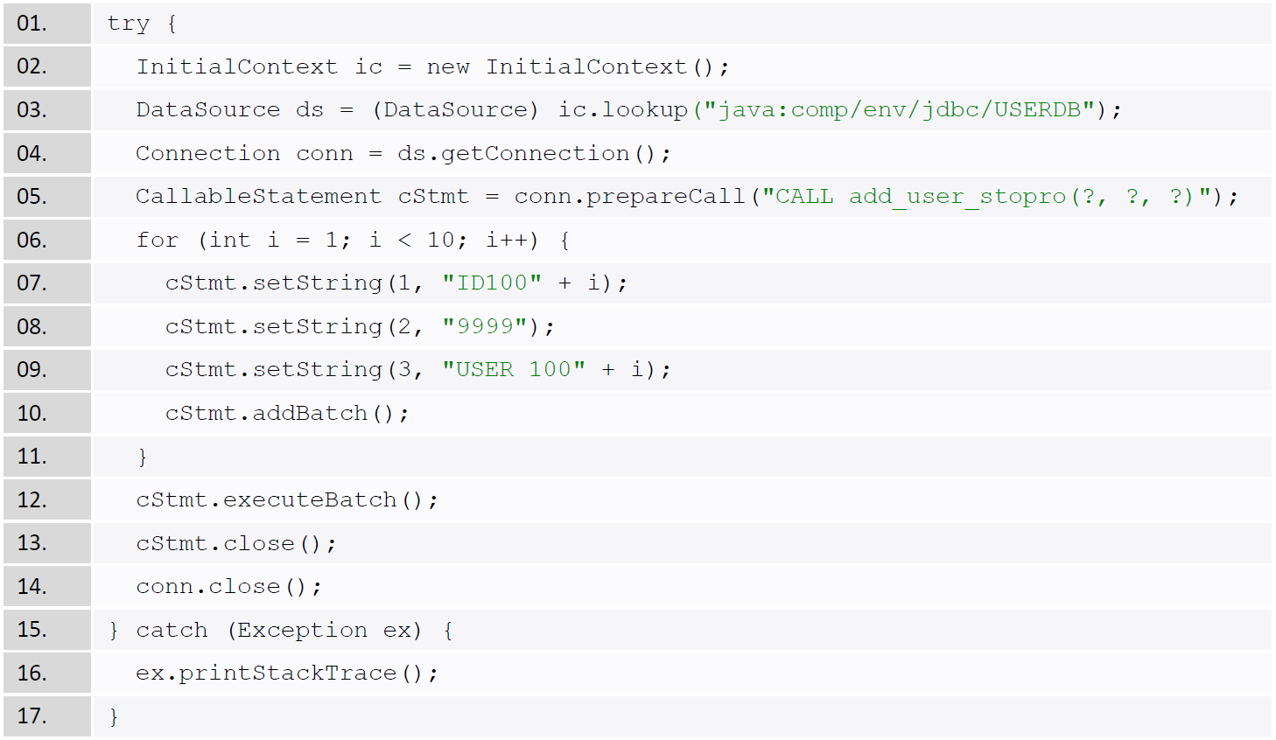
CallableStatement Example

Slide 94
ResultSetInterface

Slide 95
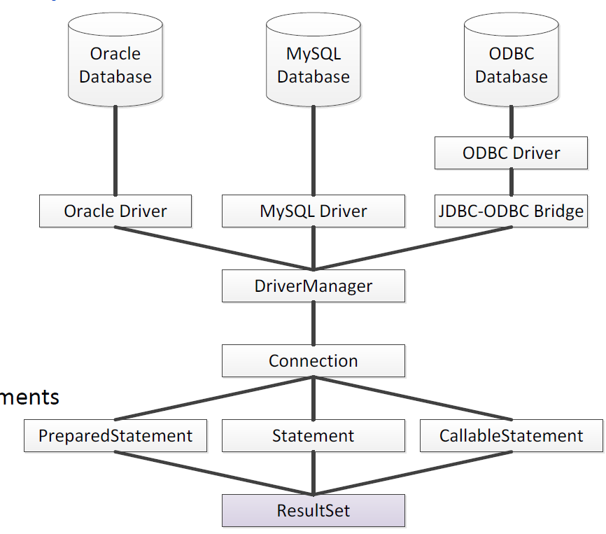
Database Development Hierarchy
Development Hierarchy in Java
1. JDBC Architecture
Four types of JDBC
DB libraries for Java
(mysql.jar, oracle.jar, etc.)
2.Driver Manager
JDBC library (inside JDK)
3.Connection
Make connection to DB
4.Statement
Store routines, SQL Statements(DCL, DDL, DML, DQL)
5.Result Set
Resulting data

Slide 96
Result Set Interface
An interface encapsulates the results of a SQL query (Statement, PreparedStatement, CallableStatement).
The java.sql.ResultSet interface provides methods to retrieve and manipulate the results of executed queries.
A default ResultSet object is not updatable and has a cursor that points to the current row of data (a record).
The ResultSet interface can iterate through cursor only once from the first row to the last row.
The most important method is next() API which will move the CURSOR to iterate through all the records retrieved.
There are (getString, getDouble, getDate, getInt, etc.) methods to retrieve data column.

Slide 97
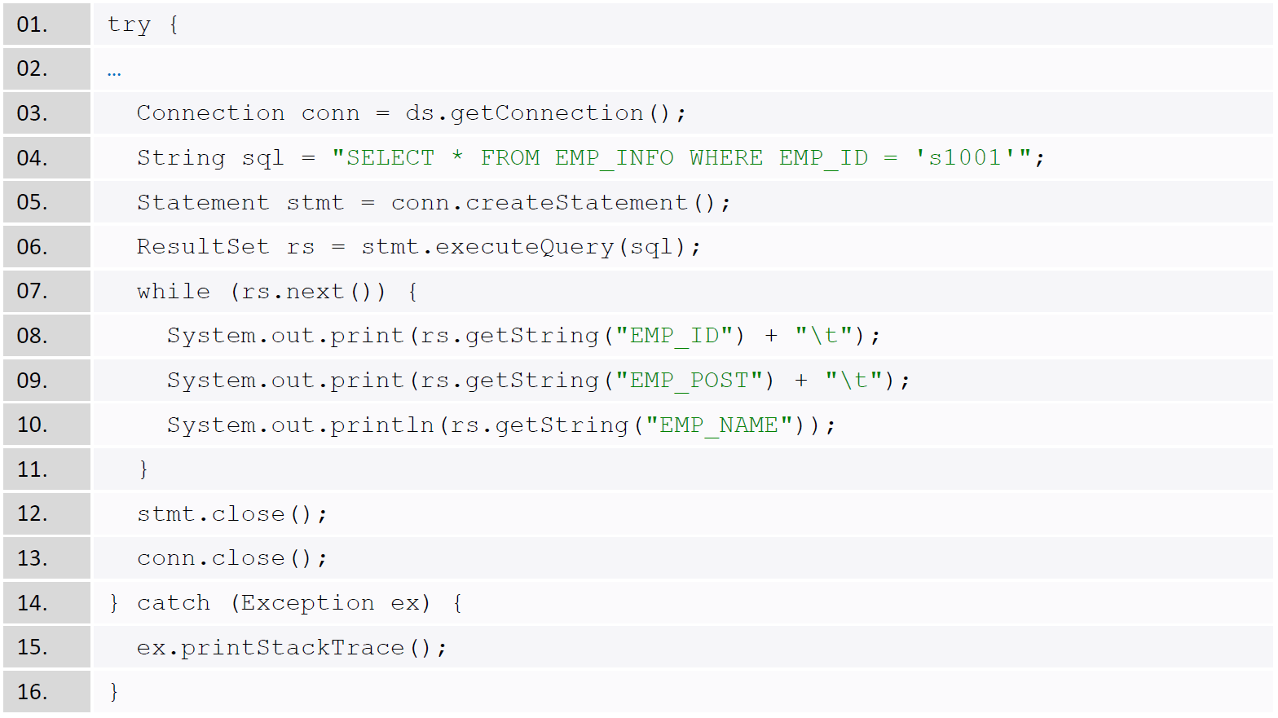
ResultSet Example

Slide 98

Retrieve data columns
getXXX(intcolumnIndex) is the preferred way of getting data. Starting from column one and in left-to-right order.
String empName= rs.getString(3);
getXXX(String columnName) might be a little bit slower because of getting the column's metadata information.
String empName= rs.getString("EMP_NAME");

Slide 99
Data persistence
O/R Mapping and Hibernate

Slide 100
Data Persistence
Transactional information will be generated in memory while running an application. When the application is terminated, the transactional information will be lost
Persistence is to store information from memory to disk, and can obtain the same set of information at a later point of time.
“Data Persistence” is a jargon in the Java world
Storing application data into a relational database.

Slide 101
What is Object / Relational Mapping?
ORM is a technique for storing, retrieving, updating, and deleting from an object-oriented program in a relational database.
Utilizes a "data layer" to manage translation between the OO and relational
The data later is typically a library written in the OO language that is part of, or works in conjunction with your web framework

Slide 102
Why Object / Relational Mapping?
Data persistence is a hot topic of debate in Java Community Process (JCP)
Is it really a problem for hand-coding the most primitive operations, CRUD (Create, Read, Update, Delete) operations with SQL and JDBC?
We only want to due with JavaBean level
Those tedious operations should be automated, and we should focus only on developing the business logics.
How to convert the JavaBean data to table?
A solution called object/relational mapping (ORM, O/R Mapping) has met with increasing acceptance.
Hibernate is an open source ORM implementation, and try to solve the problem of managing persistent data with Java in a more facilitating way.

Slide 103
The Problems Before ORM
Mapping member variables to columns
Mapping relationships
Handling data types
Managing changes to object state

Slide 104
O / R Mapping
Mapping each column of a table to JavaBean’s property
The getter methods of JavaBean to retrieve data from database.
The setter methods of JavaBean to store data in database eventually.
NOSQL: only due with objects without writing SQL statements.
Three mapping approaches for O/R mapping
Top-down mapping: create JavaBean to map each table column.
Bottom-up mapping: or called Reverse Engineering use tools (Eclipse) to read the database tables and generate the JavaBeans.
Domain modeling: tools to draw entity (table) and generate both the database script and JavaBean program.

Slide 105


ORM

Slide 106
ORM Advantages and Disadvantages:
Advantages:
Improve development efficiency and reduce development costs
Making development more object-oriented
Portable
can easily introduce additional functions such as data caching
Disadvantages:
Automated mapping of relational databases consumes system performance. In fact, the performance consumption here is OK, generally can be ignored.
The ORM syntax can be complicated when querying queries such as multiple table-checking, where conditions are complex.

Slide 107

Introduction to Hibernate
Gavin King began development of Hibernate in 2001 as an independent, non commercial and open source project.
Hibernate is a free software that is distributed under the GNU Lesser General Public License, and implements the Java Persistence API (JPA) specification conformed with the JSR 317 standard.

Slide 108
Introduction to Hibernate
A Java persistence framework to perform object relational mapping (ORM)
Persistence: allow our application data to outlive the application process.
O/R Mapping: mapping an object-oriented domain model to a traditional relational DB Hibernate Query Language (HQL): Allow SQL-like queries to access Hibernate’s objects.
Java program can treat an object (often a JavaBean) as a real relational database table for manipulation and no need to write SQL (DML, DQL)
JavaBean as table and property as column
Allow Programmer to focus on high level business logic instead of low level database coding

Slide 109
Hibernate Architecture
Database
Hibernate System consists of
Configuration file (*.cfg.xml)
Mapping files (*.hbm.xml)
Hibernate library (*.JAR)
Hibernate System API
Implement with POJOS
(Plain Old Java Objects)
or JavaBean
JDBC
Hibernate System Boundary
Mappings
Hibernate
Configuration
Client Code
POJOs

Slide 110
Hibernate Setup
Software Parts
Download the hibernate library from hibernate website.
https://hibernate.org/downloads
Add the jar files (/hibernate/lib/required/) to the web application projects.
XML Configuration Parts
hibernate.cfg.xml (declare tables and database configuration).
usertable.hbm.xml (*.hbm.xml file for mapping table columns).
Java Programming Parts
Define a JavaBean that map to the database table with the field names and data types follow the “usertable.hbm.xml” file.
SessionFactory: is a single instance to ensure only one session is used per thread (threadsafe) for client requests. All the hibernate sessions are come from this factory to communicate with database.

Slide 111


hibernate library
Maven Repository

Slide 112
Relational Database Table
Staff table structure in relational database
STAFF_ID is the primary key
CREATE DATABASE TESTDB DEFAULT CHARACTER SET UTF8 COLLATE UTF8_GENERAL_CI;
DROP TABLE IF EXISTS TESTDB.STAFF_INFO;
CREATE TABLE TESTDB.STAFF_INFO (
STAFF_ID CHAR(6) COMMENT 'STAFF IDENTIFICATION NUMBER',
STAFF_NAME VARCHAR(50) COMMENT 'STAFF NAME',
JOB_TITLE VARCHAR(50) COMMENT 'STAFF JOB TITLE',
EMPLOY_AT DATE COMMENT 'STAFF EMPLOYED DATE',
BASIC_SALARY DOUBLE COMMENT 'STAFF BASIC MONTHLY SALARY',
PRIMARY KEY(STAFF_ID)
) COMMENT 'STAFF INFORMATION TABLE';

Slide 113
Hibernate.cfg.xml (JDBC)
Hibernate configuration file
Control the whole engine
Define database connection (JDBC)
Define the configuration files for mapping tables

Slide 114
<?xml version="1.0" encoding="UTF-8"?>
<!DOCTYPE hibernate-configuration PUBLIC
"-//Hibernate/Hibernate Configuration DTD 3.0//EN"
"http://www.hibernate.org/dtd/hibernate-configuration-3.0.dtd">
<hibernate-configuration>
<session-factory name="Hibernate">
<property name="hibernate.connection.driver_class">
com.mysql.jdbc.Driver</property>
<property name="hibernate.connection.password">
123Abc__</property>
<property name="hibernate.connection.url">
jdbc:mysql://localhost:3306/testdb</property>
<property name="hibernate.connection.username">liamli</property>
<propertyname="hibernate.dialect">
org.hibernate.dialect.MySQLDialect</property>
<property name="hbm2ddl.auto">update</property>
<property name="show_sql">true</property>
<!-- table mapping -->
<mapping resource="com413/jpa/bean/stafftable.hbm.xml" />
</session-factory>

Slide 115
Mapping Documents (*.hbm.xml)
An XML to map each database table
Mapping each column of a table to a property of a JavaBean
<?xml version="1.0" encoding="utf-8"?>
<!DOCTYPE hibernate-mapping PUBLIC
"-//Hibernate/Hibernate Mapping DTD 3.0//EN"
"http://hibernate.sourceforge.net/hibernate-mapping-3.0.dtd">
<hibernate-mapping package="com413.jpa.bean">
<class name="StaffBean" table="STAFF_INFO">
<id name="staffID" column="STAFF_ID" type="java.lang.String"/>
<property name="staffName" column="STAFF_NAME" type="java.lang.String"/>
<property name="jobTitle" column="JOB_TITLE" type="java.lang.String"/>
<property name="employAt" column="EMPLOY_AT" type="java.sql.Date"/>
<property name="salary" column="BASIC_SALARY" type="java.lang.Double"/>
</class>
</hibernate-mapping>

Slide 116
StaffBean.java
package com413.jpa.bean;
import java.sql.Date;
public class StaffBean {
private String staffID;
private String staffName;
private String jobTitle;
private Date employAt;
private Double salary;

Slide 117
StaffBean.java
public String getStaffID() {return staffID;}
public void setStaffID(String staffID) {this.staffID = staffID;}
public String getStaffName() {return staffName;}
public void setStaffName(String staffName) {this.staffName = staffName;}
public String getJobTitle() {return jobTitle;}
public void setJobTitle(String jobTitle) {this.jobTitle = jobTitle;}
public Date getEmployAt() {return employAt;}
public void setEmployAt(Date employAt) {this.employAt = employAt;}
public Double getSalary() {return salary;}
public void setSalary(Double salary) {this.salary = salary;}
}

Slide 118
Hibernate Examples
The following four examples (CRUD) are showing how to manipulate database tables with objects instead of embedding SQL in a Java program
C: CreateStaff.java
R: ReadStaff.java
U: UpdateStaff.java
D: DeleteStaff.java

Slide 119
Insert a record with Hibernate
package com413.jpa.trans;
import java.sql.Date;
import org.hibernate.Session;
import org.hibernate.Transaction;
import org.hibernate.cfg.Configuration;
import com413.jpa.bean.StaffBean;
public class CreateStaff {
public static void main(String[] args) {
//Read hibernate configuration file
Configuration config = new Configuration().configure();
// Create a session for database connection
Session session = config.buildSessionFactory().openSession();
// Create a hibernate transaction
Transaction txn = session.beginTransaction();

Slide 120
Insert a record with Hibernate (cont.)
// Create a staff record with a JavaBean
StaffBean staff = new StaffBean();
staff.setStaffID("John");
staff.setStaffName("John Smith");
staff.setJobTitle("Sales Manager");
staff.setEmployAt(new Date(System.currentTimeMillis()));
staff.setSalary(Double.valueOf(50000));
// save the bean information to relational database table
session.save(staff);
txn.commit();
//Close connection to release resource
session.close();
}
}

Slide 121
Retrieve a record with Hibernate
package com413.jpa.trans;
import org.hibernate.*;
import com413.jpa.bean.StaffBean;
public class CreateStaff {
public static void main(String[] args) {
Configuration config = new Configuration().configure();
Session session = config.buildSessionFactory().openSession();
StaffBean staff = session.get(StaffBean.class, "John");
// show data
System.out.println("Staff Name: " + staff.getStaffName());
System.out.println("Job Tiltle: " + staff.getJobTitle());
System.out.println("Employ at: " + staff.getEmployAt());
System.out.println("Basic Salary: " + staff.getSalary());
session.close();
}
}

Slide 122
Update a record with Hibernate
package com413.jpa.trans;
import org.hibernate.*;
import org.hibernate.cfg.Configuration;
import com413.jpa.bean.StaffBean;
public class CreateStaff {
public static void main(String[] args) {
Configuration config = new Configuration().configure();
Session session = config.buildSessionFactory().openSession();
Transaction txn = session.beginTransaction();
StaffBean staff = session.get(StaffBean.class, "John");
staff.setJobTitle("Marketing Manager");
session.update(staff);
txn.commit();
session.close();
}
}

Slide 123
Delete a record with Hibernate
package com413.jpa.trans;
import org.hibernate.*;
import org.hibernate.cfg.Configuration;
import com413.jpa.bean.StaffBean;
public class CreateStaff {
public static void main(String[] args) {
Configuration config = new Configuration().configure();
Session session = config.buildSessionFactory().openSession();
Transaction txn = session.beginTransaction();
StaffBean staff = session.get(StaffBean.class, "John");
session.delete(staff);
txn.commit();
session.close();
}
}

Slide 124
Hibernate Advantages
Productivity
Eliminates the most tedious codes for data persistent in Java Application.
Let programmers concentrate on business problems.
It will significantly reduce development time.
Performance
Hibernate provides more optimizations to the SQL statement.

Slide 125
Hibernate Advantages (cont’d)
Maintainability
Required fewer code for implementation, that reduce the maintenance jobs.
In hand-coded persistence approach, changing the table structure will cause the relative programs to change. However, it only required to remap the JavaBean in Hibernate application.
Separation of roles (database administrator and application developer).
Modern Technologies
Armed yourself with modern Java EE technologies.

Slide 126
Database Optimization

Slide 127
Database Performance
The default database engine configuration approach is to use the minimal resource. Therefore, enterprise database servers must optimize in order to achieve high performance
Hardware level: threading, memory balancing, network data storing, distributing, etc.
Software level: indexing, caching, query optimizing, pooling, etc.
Application level: data type choosing, concurrency controlling, data loading, etc.
Miscellaneous: read the textbooks and manuals to use the native database libraries to use the native database libraries
It is almost impossible to say a set of configuration that can fit all situations in the various enterprise environments.

Slide 128
Changing the default values
In general, database engines will not set for large volume of data flowing.So, system administrators are required to change the default values for the enterprise level systems.
Changes should be made in little because big changes may use up the available resources. As a result, the server services may even fail to start.
The common configurable variables for database are:
thread_cache_size, query_cache_size, buffer_size, additional_mem_pool_size, buffer_pool_size, max_connections, max_allowed_packet, etc.
They can be found in MySQL Workbench software
http://dev.mysql.com/doc/refman/8.0/en/server-system-variables.html

Slide 129

MySQL Administration

Slide 130
Common Variables
Buffer Pool
Caches indexes, holds row data, adaptive hash index, insert buffer, locks and some internal structure.
Delay a write and merge many writes together.
MySQL manual suggests using up to 80% of the physical memory.
Thread Cache
Specify the number of threads MySQL can keep in the cache.
Holds threads that aren't currently associated with a connection.
Keeps the thread cache just large enough to handle workload.
Table Cache
Similar concept to thread cache but it stores objects for table.
Maximum Connection
The maximum number of simultaneous client connections and default is 151.

Slide 131
Database Tablespace
A tablespace is a storage location where the actual data underlying database objects can be kept.
C:\MySQL\data\
https://dev.mysql.com/doc/refman/8.0/en/general-tablespaces.html
It consists of a chain of files. The size of the files does not have to be divisible by the database block size, because we may just leave the last incomplete block unused.
Tablespaces specify only the database storage locations, not the logical database structure, or database schema.
When a new file is appended to the tablespace, the maximum size of the file is also specified.

Slide 132
Tablespace Management
MySQL (InnoDBengine) creates the default tablespace files and the additional files will be created on demand.
https://dev.mysql.com/doc/refman/8.0/en/create-tablespace.html
CREATE TABLE T1 (…) TABLESPACE TS1 ROW_FORMAT=COMPACT;
Based on the access frequency, read & write purpose, user authority, or others considerations to separate tables into different tablespaces.
For example, a heavily used index can be placed on a fast SSD. On the other hand, a database table which contains archived data that is rarely accessed could be stored on a less expensive but slower magnetic hard drive.

Slide 133
Index Maintenance
Indexes (also called keys) are data structures that help MySQL to retrieve data efficiently
It is liked the Table Of Content (TOC) in a book where you can find a chapter with page number quickly
It is the most critical part to affect database performance, people often forget about it.
Database engines implement index with different approaches
B-Tree, R-Tree, Hash, Full-text, etc.
Therefore, we must manage the table indexes
Creating prefix/suffix indexes
Repairing indexes

Slide 134
Creating (Prefix/Suffix) Indexes
When indexing a very long character column, it will be very slow. Prefix Index will only index the head of the column
You can save spaces and get good performance by indexing the first few characters instead of the whole word(s)
Some times, suffix indexes (the tail of the column) is more efficient than prefix indexes
CNT | CITY
65 | London
49 | Hiroshima
48 | Teboksary
49 | Pak Kret
CNT | CITY
65 | Lon
49 | Hir
48 | Teb
49 | Pak

Slide 135
Repairing Indexes
Once you’ve created tables, your jobs is not finished and actually it is the beginning stages of maintenance
Since there are transactions changing the table contents (DML: insert, update, delete), it will affect the indexes inside the page files to cause index fragmentation
Delete records
Page-split in B-tree
Index fragmentation will significantly lower the searching efficiency. Sometimes, it will even corrupt the index files
These are the main areas for repairing indexes
Finding and Repairing Corruption
Updating Index Statistics

Slide 136
Sample Table
CREATE TABLE STAFF_INFO(
STAFF_ID CHAR(6),
STAFF_NAME VARCHAR(50)
JOB_TITLE VARCHAR(50)
EMPLOY_AT DATA,
BASIC_SALARY DOUBLE,
PRIMARY KEY(STAFF_ID)
);
Sample content (table has 10,000 records)
STAFF_ID | STAFF_NAME | JOB_TITLE | EMPLOY_AT | BASIC_SALARY
ID001 | Paul Chan | OFFICER | 1999-12-03 | 10000.00
ID002 | Joe Yeung | CLERK | 2000-03-24 | 23000.00
ID003 | Pinky Lam | MANAGER | 2012-05-07 | 35000.00
…

Slide 137
Finding and Repairing Corruption
Table indexes will be corrupted because of frequently access (DML)
Corrupted indexes can cause queries to return incorrect results, raise duplicate key errors when there is no duplicated value, or even cause lockups and crashes
When there are some odd behaviors happened in a table, use CHECK TABLE command to see the status of the table
CHECK TABLE STAFF_INFO;
+---------------+----------+-------------+-----------+
| TABLE | OP | MSG_TYPE | MSG_TEXT |
+---------------+----------+-------------+-----------+
| staff_info | check | error | Corrupt |
+---------------+----------+-------------+-----------+

Slide 138
Finding and Repairing Corruption
Use REPAIR TABLE command to fix the corruption
The worst case will lose the data from your last backup
REPAIR TABLE STAFF_INFO;
+---------------+----------+-------------+-----------+
| TABLE | OP | MSG_TYPE | MSG_TEXT |
+---------------+----------+-------------+-----------+
| staff_info | repair | status | Ok |
+---------------+----------+-------------+-----------+

Slide 139
Updating Index Statistics
Amending the table content by transactions may cause the index fragmentation (too many empty spaces in the index files)
MySQL query optimizer uses two APIs to see how index values are distributed.
records_in_range(): return the number of records
info(): return various types of data
When these two APIs cannot return accurate information, the optimizer will use Index Statistics to regenerate the results for them
MySQL will use ANALYZE TABLE command
Index Statistics will simply to rebuild the indexes of a table
However, updating the indexes statistics will require to lock the table and consume resources
It is suggested to run this rebuild indexes job at night (non peak hours). This practice can commonly found in Online Transaction Processing system (OLTP)

Slide 140
Index Statistics Example
Index cardinality: the number of unique values in the index
Use the SHOW command to see the index cardinality
SHOW INDEX FROM STAFF_INFO STAFF_INFO;
+---------------+-----------+---------------+--------------+---
| TABLE | KEY_NAME | COLUMN NAME | CARDINALITY |...
+---------------+-----------+---------------+--------------+---
| staff_info | PRIMARY | STAFF_ID | 1340 |...
+---------------+-----------+---------------+--------------+---

Slide 141
Index Statistics Example
Use ANALYZE TABLE to rebuild the index in MySQL
Check the table again
ANALYZE TABLE STAFF_INFO;
+---------------+----------+-------------+-----------+
| TABLE | OP | MSG_TYPE | MSG_TEXT |
+---------------+----------+-------------+-----------+
| staff_info | analyze | status | Ok |
+---------------+----------+-------------+-----------+
SHOW INDEX FROM STAFF_INFO STAFF_INFO;
+---------------+-----------+---------------+--------------+---
| TABLE | KEY_NAME | COLUMN NAME | CARDINALITY |...
+---------------+-----------+---------------+--------------+---
| staff_info | PRIMARY | STAFF_ID | 10000 |...
+---------------+-----------+---------------+--------------+---

Slide 142
Database Maintenance
Programmers design the databases and tables for their applications on the development stage. Once the tables are created they will consider their jobs are finished. In fact, the maintenance jobs are just begins.
In order to keep the database healthy and efficient, plenty of maintenance jobs are required
Modifying table spaces, controlling user authority, generating and extracting data for other application, updating indexes, backup, etc.
Different database engine will have their native command styles and syntaxes but the ideas are the same.

Slide 143
Case Study

Slide 144
Case Study: Uber (Online Taxi Service)
PostgreSQL served well in the early days of Uber, but Uber ran into significant problems when scaling PostgreSQL with the growth
Then, Uber engineers changed the database from PostgreSQL to MySQL
References:
Why Uber Engineering switched from PostgreSQL to MySQL?
https://eng.uber.com/mysql-migration/
https://yq.aliyun.com/articles/58421
MySQL might be right for Uber but not for you
https://dzone.com/articles/on-ubers-choice-of-databases
https://coyee.com/article/10766-mysql-might-be-right-for-uber-but-not-for-you

Slide 145
PostgreSQL vs MySQL
Uber is a typical update-heavy-use-cases
(Trip data) keeping track of a taxi's status at any time
Data Structure
PostgreSQL uses B-tree
It needs to follow the path from the root to the leafs in order to get the data
MySQL uses B+ tree (Perform better on query)
It walks through the leafs and has to follow the path to the leafs only the first time
On update
PostgreSQL always needs to update all indexes on a table when updating rows in the table
MySQL needs to update only those indexes that contain updated columns

Slide 146
PostgreSQL vs MySQL (cont.)
On Select
MySQL uses clustered indexes when doing the secondary key lookup where PostgreSQL has only one
MySQL is good for key/value store to run simple SQL query
On Index Rebalancing
The index balance in PostgreSQL is maintained with every single index change to balance the tree
In some cases, the new node cannot be added to the parent node straight away because the parent node doesn't have enough space for the new child entry. In this case, the parent node is split and everything repeats

Slide 147
PostgreSQL vs MySQL (cont.)
On Physical Replication
PostgreSQL has a replication bug that can cause data corruption on the downstream servers
Replicas followed timeline switches incorrectly, causing some of them to misapply some records (duplicate or mismatch records appear)
PostgreSQL is not suitable in Uber's case but it work fine in other situations
Uber still have some legacy Postgres instances, but the bulk of databases are built on top of MySQL or even some NoSQL databases.

Slide 148
summary
Four types of JDBC architecture
For connecting database in different environments
JNDI & DBCP
For accessing high performance databases
Statement Interfaces, ResultSet Object
For manipulating data with Java programming language
Stored Procedures
Procedure, function, and trigger
Database Optimization
For tuning up the database engines, distributing user requests

